Slide 1

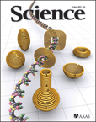
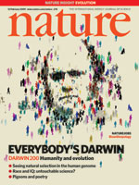
How to Write Great Papers
From title to references
From submission to acceptance
Presented by: Monique Lamine
Director Contract Publishing
Innovation & Publishing Development
STMjournals

Slide 2
Workshop Outline
Trends in publishing
How to get published
  Before you start
  Select your audience
  Tips for language
  The article structure
The review and editorial process
What not to do... (author ethics)

Slide 3
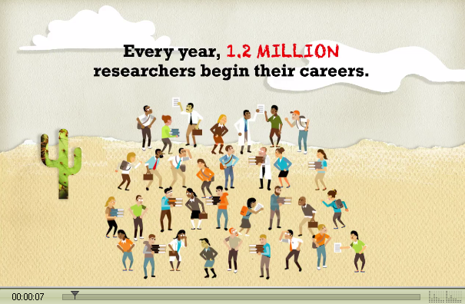
Today’s research environment
...where the young researchers need guidance.

Slide 4
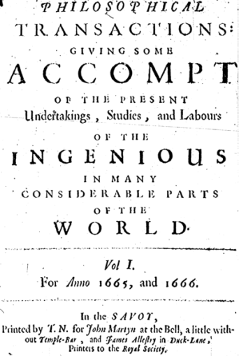
Peer-Reviewed Journal Growth 1665-2001
10000
No of titles launched and still extant 2001
100
Philosophical Transactions
of the Royal Society (London)
2009
1,4 million articles
in 23,000 journals
by 2,000 publishers
1
1665
1765
1865
1965
Year
Source:
M A Mabe The number and growth of journals
Serials 16(2).191-7, 2003

Slide 5
Article Share
Share of Journal Articles Published
Our Scientific Disciplines
Environmental Sciences
Earth Sciences
Social Sciences
26%
Elsevier
Life sciences
26%
Maths & computer science
Others
Others
Physics
Wiley-Blackwell
Chemistry & Chemical Engineering
Health sciences
APS
IOP
Springer
IEEE
Taylor & Francis
AIP
ACS
Materials Science & Engineering
Wolters Kluwer
Over one million English language research
articles published globally each year
About 1000 English language research
articles published with Elsevier today
Notes:
And with a 1000 articles today, I really mean today! (i.e. 1000 per day) To further emphasise the industrial scale of our operations you could note that by the time you’ve finished this presentation elsevier will have published the annual output of their journal…. And industrial scale requerers careful experimenting and scaling…

Slide 6

Elsevier Journal publishing volume
1,000 new editors per year
20 new journals per year
600,000+ article submissions per year
Organise editorial boards
Launch new specialist journals
Solicit and manage submissions
200,000 reviewers
1 million reviewer reports per year
11 million articles now available
Archive and promote
Manage peer review
40%-90% of articles rejected
11 million researchers
5,000+ institutions
180+ countries
400 million+ downloads per year
3 million print pages per year
7,000 editors
70,000 editorial board members
6.5 million author/publisher communications /year
Publish and disseminate
Edit and prepare
Production
280,000 new articles produced per year
190 years of back issues scanned, processed and data-tagged

Slide 7
Trends in publishing; print is so 1990
Rapid conversion from “print” to “electronic”
  1997: print only
  2009: 55% e-only (mostly e-collections)
  25% print only
  20% print-plus-electronic
Changing role of “journals” due to e-access
Increased usage of articles
  At lower cost per article
Electronic submission
  Increased manuscript inflow
Experimentation with new publishing models
  E.g. “author pays” models, “delayed open access”, etc.

Slide 8








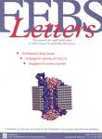

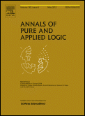



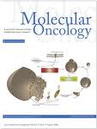




Open Access
Author processing fee per article published – sole mechanism to support journal
Some journals use subsidies, grants and waivers
Often referred to as “gold” open access
EXAMPLES
Elsevier has 14 OA journals
Option to make an article within a subscription journal open access
Supported by several funding organisations
Often referred to as the hybrid model
EXAMPLES
Elsevier has 1,200 journals that offer this service
Agreements with RCUK, Wellcome Trust, FWF, Telethon
Open Access Journals
Sponsored Articles
Free Access to Archive
Manuscript Posting
Open Access
Subscription journals making articles freely available online after time delay
Time to free access varies due to differences in subject fields
EXAMPLES
Over 90 Elsevier journals now offer this solution in fields such as medicine, life sciences and mathematics
Posted manuscripts, or pre-prints to websites and repositories
Supported by many universities and research organisations
Often referred to as “green” open access
Elsevier has a very liberal posting policy that supports researcher needs
Agreements developed with institutions to facilitate deposit

Slide 9

Your personal reasons for publishing?
Get funding?
Get promoted?
PhD degree?
…???
However, editors, reviewers, and the research community don’t consider these reasons when assessing your work.

Slide 10



Always keep in mind that…
…your published papers, are a permanent record of your research, are your passport to your community…

Slide 11

Why publish?
Publishing is one of the necessary steps embedded in the scientific research process. It is also necessary for graduation and career progression.
What to publish:
New and original results or methods
Reviews or summaries of a particular subject
Manuscripts that advance the knowledge and understanding in a certain scientific field
What NOT to publish:
  Reports of no scientific interest
  Out of date work
  Duplications of previously published work
  Incorrect/unacceptable conclusions
You need a STRONG manuscript to present your contributions to the scientific community

Slide 12
What is a strong manuscript?
Has a novel, clear, useful, and exciting message
Presented and constructed in a logical manner
Reviewers and editors can grasp the scientific significance easily
Editors and reviewers are all busy scientists –
make things easy to save their time
Notes:
The scientific message must be clear, useful, and exciting
The author’s messages must be presented and constructed in a logical manner. The reader should arrive at the same conclusions as the author. The format chosen should best showcase the author’s material.
Readers, reviewers, and editors should be able to easily grasp the scientific significance of the research
Editors, reviewers and readers all want to save time and not waste it.

Slide 13
How To Get Your Article Published
Before you start

Slide 14

Refine your search strategies
Too many researchers have abandoned all the value of libraries when they stopped going there physically!
There is more than
Learn what online resources are available at your institute, and learn to search in a clever way.
Haglund & Olson, 2008:
“…researchers have difficulties in identifying correct search terms. Searches are often unsuccessful.”

Slide 15
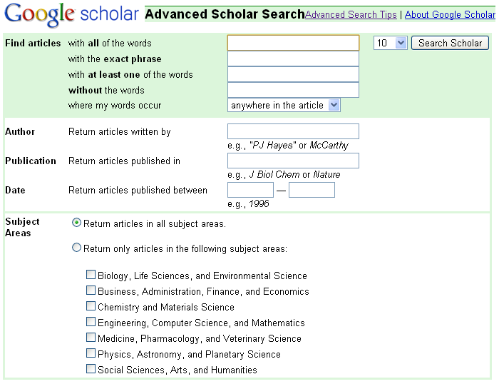
Use the advanced search options
Within Google and Google Scholar use the advanced searches and check out the Search Tips.
In ScienceDirect, Scopus, WoS/WoK and other databases use proximity operators:
  w/n
  pre/n
  E.g. wind w/3 energy
Within - (non order specific)
Precedes - (order specific)

Slide 16


Practical advice
Find out what’s Hot
  http://info.scopus.com/topcited/
  http://top25.sciencedirect.com/
  http://www.scitopics.com/
Find the trends of the subject area
  Search tips (including alerts)
  Journals, authors, publications per year (Scopus)
Evaluate which journal is right for your article
  Impact Factor
  Subject Specific Impact Factor (http://tinyurl.com/scopusimpact)
  SCImago Journal & Country Ranking (http://scimagojr.com/)
  Journal Analyzer
  SNIP (using Scopus)
  h-Index
Find out more about the journals
  Who are the editors?
  Guide for authors
IF

Slide 17
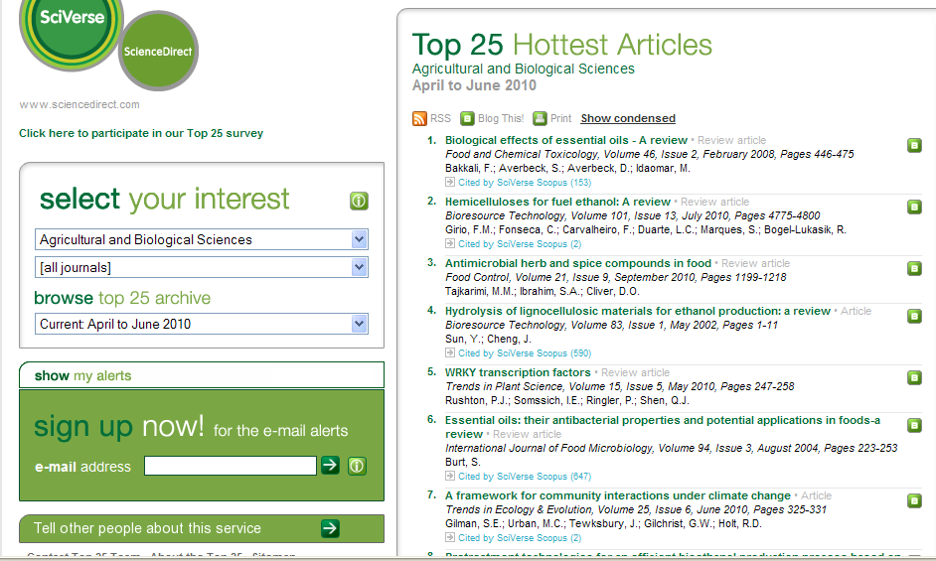
Find out what’s hot (downloads)

Slide 18
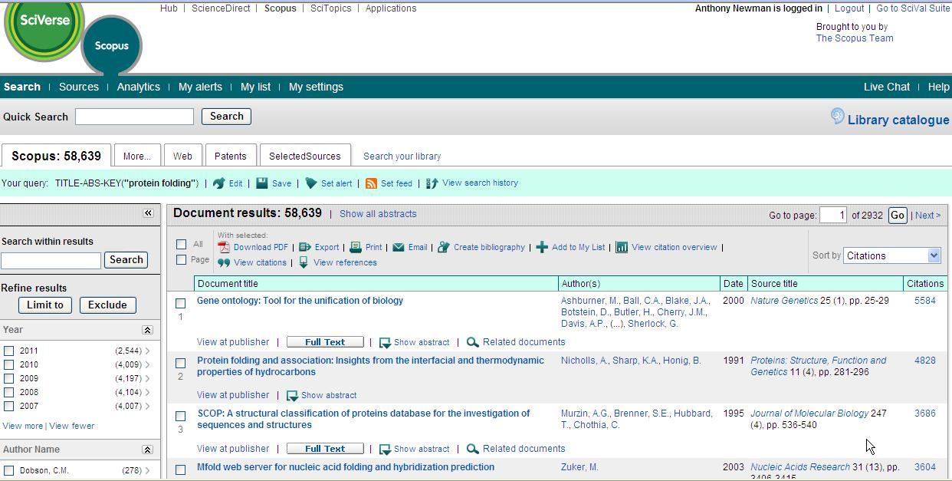
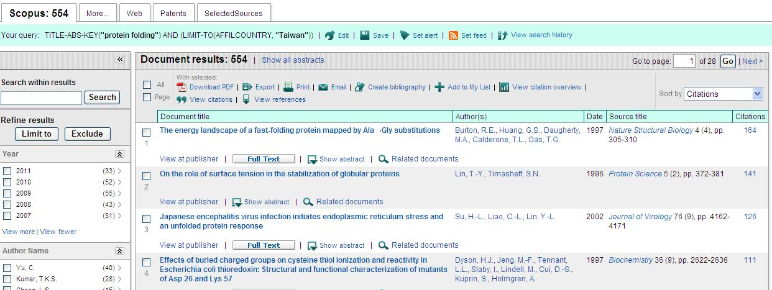
Find out what is being cited

Slide 19
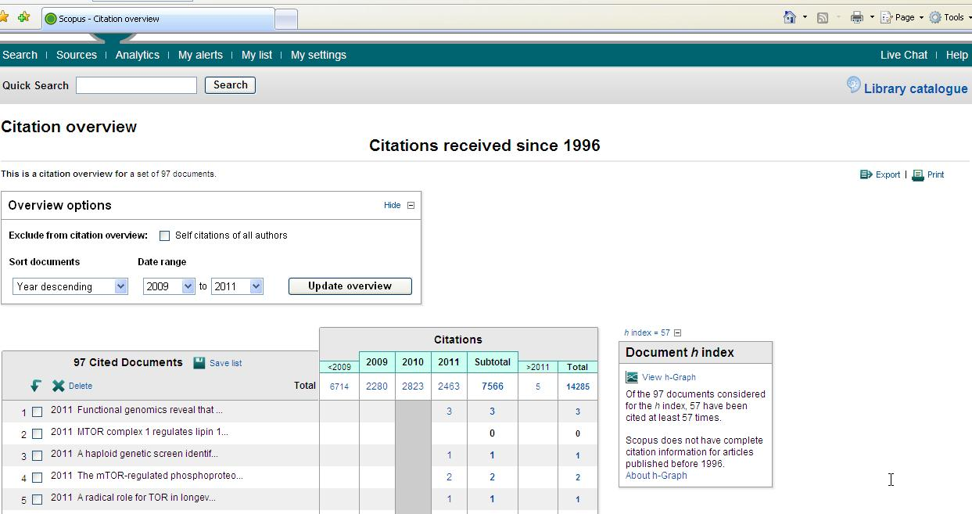
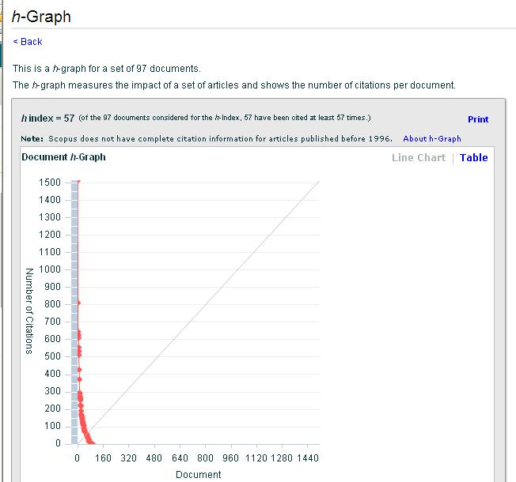
Find out who is being cited – in more depth

Slide 20

Questions to answer before you write
Think about why you want to publish your work.
  Is it new and interesting?
  Is it a current hot topic?
  Have you provided solutions to some difficult problems?
  Are you ready to publish at this point?
If all answers are yes, then start preparations for your manuscript.

Slide 21
Decide the most appropriate type of manuscript
Conference Papers
Full articles/Original articles
Short communications/letters
Review papers/perspectives
  Self-evaluate your work: Is it sufficient for a full article? Or are your results so thrilling that they need to be shown as soon as possible?
  Ask your supervisor and colleagues for advice on manuscript type. Sometimes outsiders see things more clearly than you.
Notes:
There are different types of manuscripts to suit different purposes:
Conference Papers
Full Articles – The most important and frequently used type. Often substantial completed pieces of research that are of significance.
Short Communications– quick and early communications of significant, original advances. Much shorter than full articles.
Review papers – They summarize recent developments on a specific topic. Highlighting important points that have been previously reported and introducing no new information. Often submitted on invitation.
Self-evaluate your work. Is it sufficient for a full article? Or are your results so thrilling that they should be shown as soon as possible?
Ask your supervisor and your colleagues for advice on manuscript type. Sometimes outsiders can see things more clearly than you.

Slide 22
Conference Paper
Excellent for disseminating early or in-progress research findings
Typically 5-10 pages, 3 figures, 15 references
Draft and submit the paper to conference organisers
Good way to start a scientific research career
Sample Conference Paper titles:
“Global Warming Prevention Technologies in Japan” at 6th Greenhouse Gas Control Technologies International Conference
“Power consumption in slurry systems” at 10th European Conference on Mixing
Notes:
Conference Papers
1. Excellent for disseminating early or in-progress research findings
2. Typically 5-10 pages, 3 figures, 15 references
3. Draft and submit the paper to conference organisers
4. Good way to start a scientific research career
Sample full article titles from ScienceDirect.

Slide 23
Full article / Original article
Standard for disseminating completed research findings
Typically 8-10 pages, 5 figures, 25 references
Draft and submit the paper to appropriate journal
Good way to build a scientific research career
Sample full article titles:
“Hydrodynamic study of a liquid/solid fluidized bed under transverse electromagnetic field”
“Retinoic acid regulation of the Mesp–Ripply feedback loop during vertebrate segmental patterning”
“Establishing a reference range for bone turnover markers in young, healthy women”
Notes:
Full articles/Original articles:
1. Standard for disseminating completed research findings
2. Typically 8-10 pages, 5 figures, 25 references
3. Draft and submit the paper to appropriate journal
4. Good way to build a scientific research career
Sample full article titles from ScienceDirect; generally more pointed and specific than conference papers or review papers.

Slide 24

Short Communications Article
Quick and early communications of significant, original advances.
Much shorter than full articles.
Notes:
Short Communications

Slide 25
Review paper / perspective
Critical synthesis of a specific research topic
Typically 10+ pages, 5+ figures, 80 references
Typically solicited by journal editors
Good way to consolidate a scientific research career
Sample full article titles:
“Advances in the allogeneic transplantation for thalassemia”
“Stress and how bacteria cope with death and survival”
“Quantifying the transmission potential of pandemic influenza”
Notes:
Review Papers/perspectives
1. Critical synthesis of a specific research topic
2. Typically 10+ pages, 5+ figures, 80 references
3. Typically solicited by journal editors
4. Good way to consolidate a scientific research career
Sample review paper titles from ScienceDirect show how the topics are specific, but not as granular as those covered by full articles.

Slide 26
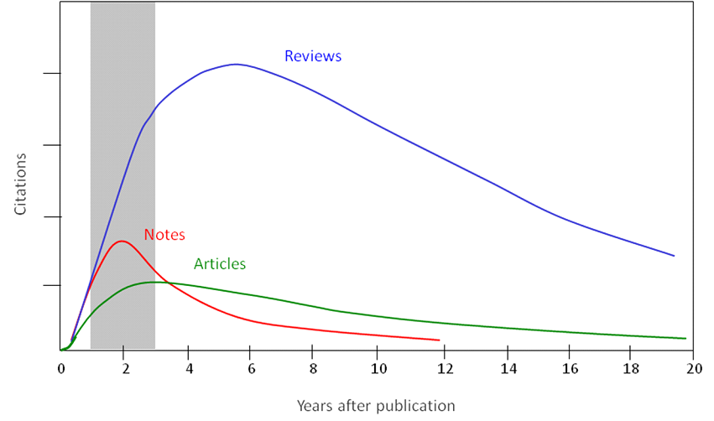
Citations impact varies by publication type
Notes:
This chart shows how the different article types get treated and used differently with review articles being much more highly cited than full articles or conference papers.
[Note: This data was based on articles published 1996 (in English) in Materials Science journals or conference proceedings]

Slide 27
Select the best journal for submission
  Look at your references – these will help you narrow your choices.
  Review recent publications in each candidate journal. Find out the hot topics, the accepted types of articles, etc.
  Ask yourself the following questions:
    Is the journal peer-reviewed?
    Who is this journal’s audience?
    What is the journal’s Impact Factor?
  Do not gamble by submitting your manuscript to more than one journal at a time!
    International ethics standards prohibit multiple/simultaneous submissions, and editors do find out! (Trust us, they do!)
Notes:
S

Slide 28
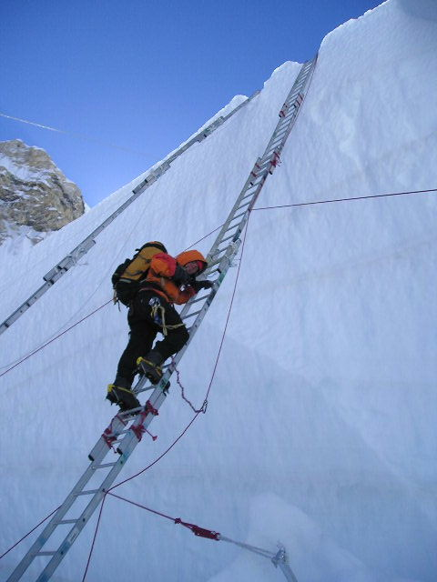
Choose the right journal
Do not just “descend the stairs”
Top journals
Nature, Science, Lancet, NEJM, ......
Field-specific top journals
Other field-specific journals
National journals

Slide 29

Identify the right audience for your paper
Identify the sector of
  readership/community
  for which the paper is meant
Identify the interest of your audience
Is your paper of local or international interest?
Ask your Professor / advisor

Slide 30
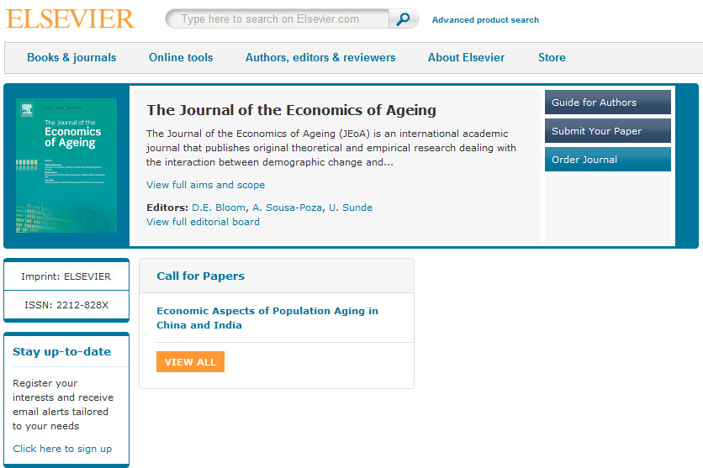
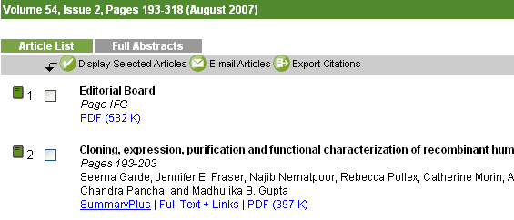
Choose the right journal
Investigate all candidate journals to find out
  Aims and scope
  Accepted types of articles
  Readership
  Current hot topics
  go through the abstracts of recent publications)

Slide 31
What is the Impact Factor (IF)?
Impact Factor
The number of citations in year x to articles published in years x−1 and x−2, divided by the total number of "source items" published in J in years x−1 and x−2.
For example, the 2011 impact factor for a journal is calculated as follows:
  A = the number of times articles published in 2009 and 2010 were cited in indexed journals during 2011
  B = the number of "citable items" (usually articles, reviews, proceedings or notes; not editorials and letters-to-the-Editor) published in 2009 and 2010
  2011 impact factor = A/B
  e.g. 600 citations = 2.000
  150 + 150 articles
Notes:
There are too many occasions that need your to consult the Guide for Authors. We will mention them later!

Slide 32
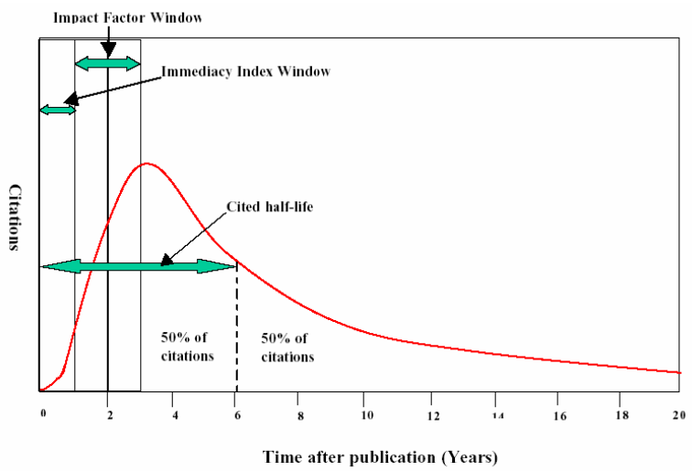
Impact Factor and other bibliometric parameters

Slide 33
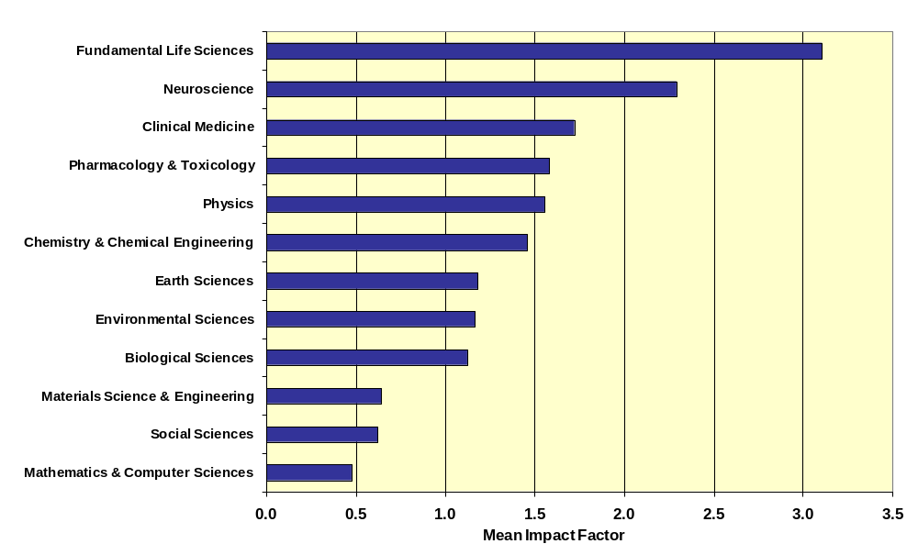
Influences on Impact Factors: Subject Area

Slide 34
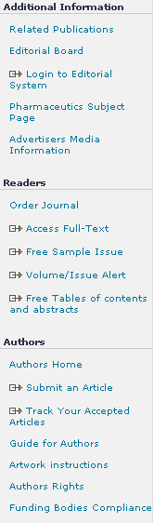
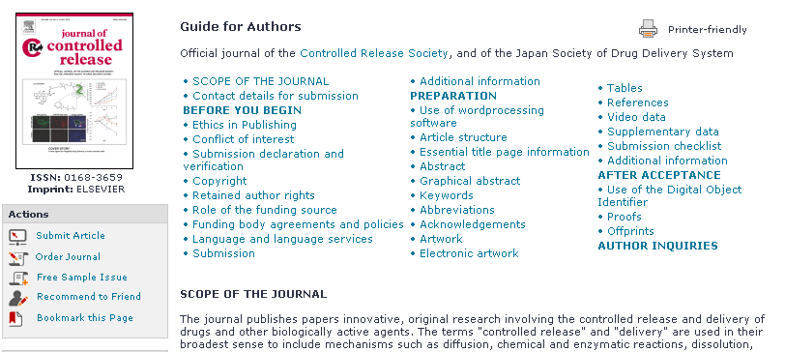
Read the Guide to Authors - Again and again!
Stick to the Guide for Authors in your manuscript, even in the first draft (text layout, nomenclature, figures & tables, references etc.).
In the end it will save you time, and also the editor’s.
Editors (and reviewers) do not like wasting time on poorly prepared manuscripts. It is a sign of disrespect.

Slide 35
An international editor says…
“The following problems appear much too frequently”
  Submission of papers which are clearly out of scope
  Failure to format the paper according to the Guide for Authors
  Inappropriate (or no) suggested reviewers
  Inadequate response to reviewers
  Inadequate standard of English
  Resubmission of rejected manuscripts without revision
  – Paul Haddad, Editor, Journal of Chromatography A
Notes:
Haddad, JCA

Slide 36
How can I ensure I am using proper
manuscript language?

Slide 37
Thought Question
What are some characteristics of the best manuscript writing you
have seen?
Notes:
Thought question on scientific writing to gauge audience level’s experience and familiarity with scientific writing skills.

Slide 38
Why is language important?
Save your editor and reviewers the trouble of guessing what you mean
Complaint from an editor:
“[This] paper fell well below my threshold. I refuse to spend time trying to understand what the author is trying to say. Besides, I really want to send a message that they can't submit garbage to us and expect us to fix it. My rule of thumb is that if there are more than 6 grammatical errors in the abstract, then I don't waste my time carefully reading the rest.”
Notes:
Scientific language is a necessary and important consideration since it is one of the easiest ways for an editor or reviewer to not grasp the message of your work.
Actual editor complaint used for effect and as an example of how editors cannot afford to waste time on language deficiencies.

Slide 39
Do publishers correct language?
No. It is the author’s responsibility to make sure his paper is in its best possible form when submitted for publication
However:
  Publishers often provide resources for authors who are less familiar with the conventions of international journals. Please check your publishers’ author website for more information.
  Some publishers may perform technical screening prior to peer review.
  Visit http://webshop.elsevier.com for translation and language editing services.
Notes:
No. It is the author’s responsibility to make sure his paper is in its best possible form when submitted for publication
However:
Publishers often provide resources for authors who are less familiar with the conventions of international journals . Please check your publishers’ author website for more information.
Some publishers may perform technical screening prior to peer review

Slide 40
Scientific Language – Overview
Write with clarity, objectivity, accuracy, and brevity.
Key to successful scientific writing is to be alert for common errors:
  Sentence construction
  Incorrect tenses
  Inaccurate grammar
  Not using English
Check the Guide for Authors
of the target journal for language specifications
Notes:
The key is to write clearly, objectively, accurately, and with brevity or concision.
The most common errors are as follows and I will go into each one of these in the subsequent slides.
Sentence construction
Incorrect tenses
Inaccurate grammar
Not consistent use of English throughout the paper.
Once again, language specifications can also be referenced at the Guide for Authors.
Foreign language students should practice writing English at any moment they can. Maybe keep records in English during the research?

Slide 41
Scientific Language – Sentences
Write direct and short sentences
One idea or piece of information per sentence is sufficient
Avoid multiple statements in one sentence
An example of what NOT to do:
“If it is the case, intravenous administration should result in that emulsion has higher intravenous administration retention concentration, but which is not in accordance with the result, and therefore the more rational interpretation should be that SLN with mean diameter of 46nm is greatly different from emulsion with mean diameter of 65 nm in entering tumor, namely, it is probably difficult for emulsion to enter and exit from tumor blood vessel as freely as SLN, which may be caused by the fact that the tumor blood vessel aperture is smaller.”
Notes:
1. Sentences should be constructed in short, factual bursts. Long sentences confuse readers.
Short sentences look more professional. The average length of sentences in scientific writing is about 12-17 words.
Only one idea should be conveyed per sentence.
The example given is an extreme case of a very long run-on sentence. When read, the messages are easily lost.

Slide 42
How do I build up my article
properly?

Slide 43

General structure of a Research Article
Title
Abstract
Keywords
Main text (IMRAD)
  Introduction
  Methods
  Results
  And
  Discussions
Conclusion
Acknowledgement
References
Supplementary data
Make them easy for indexing and searching (informative, attractive, effective)
Journal space is not unlimited, more importantly, your reader’s time is scarce.
Make your article as concise as possible.

Slide 44
The process of writing – constructing the article
Title & Abstract
Conclusion
Introduction
Methods
Results
Discussion
Figures / Tables (your data)

Slide 45
Authorship
Policies regarding authorship can vary
One example: the International Committee of Medical Journal Editors (“Vancouver Group”) declared that an author must:
  Substantially contribute to conception and design, or acquisition of data, or analysis and interpretation of data;
  Draft the article or revise it critically for important intellectual content; and
  Give their approval of the final full version to be published.
  All three conditions must be fulfilled to be an author!
All others would qualify as “Acknowledged Individuals”

Slide 46
Authorship - Order & Abuses
General principles for who is listed first
  First Author
    Conducts and/or supervises the data generation and analysis and the proper presentation and interpretation of the results
    Puts paper together and submits the paper to journal
  Corresponding author
    The first author or a senior author from the institution
      Particularly when the first author is a PhD student or postdoc, and may move to another institution soon.
Abuses to be avoided
  Ghost Authorship: leaving out authors who should be included
  Gift Authorship: including authors who did not contribute
  significantly

Slide 47
Acknowledged Individuals
Recognize those who helped in the research, but do not qualify as authors (you want them to help again, don’t you?)
  Include individuals who have assisted you in your study:
    Advisors
    Financial supporters
    Proof-readers
    Typists
    Suppliers who may have given materials

Slide 48
Author names: common problems
Different Spellings
  Järvinen / Jaervinen / Jarvinen
  Lueßen / Lueben / Luessen
  van Harten / Vanharten / Van
First/Last Names
  Asian names often difficult for Europeans or Americans
What in case of marriage/divorce?
Be consistent!
  If you are not, how can others be?
Notes:
GB/T 16159-1996, Authors are suggested to indicate the surname and the first name in the author names.

Slide 49
Title
A good title should contain the fewest possible words that adequately describe the contents of a paper.
Effective titles
  Identify the main issue of the paper
  Begin with the subject of the paper
  Are accurate, unambiguous, specific, and complete
  Are as short as possible
  Articles with short, catchy titles are often better cited
  Do not contain rarely-used abbreviations
  Attract readers - Remember: readers are the potential authors who will cite your article

Slide 50
Title: Examples
Original Title
Revised
Remarks
Preliminary observations on the effect of Zn element on anticorrosion of zinc plating layer
Effect of Zn on anticorrosion of zinc plating layer
Long title distracts readers.
Remove all redundancies such as “observations on”, “the nature of”, etc.
Action of antibiotics on bacteria
Inhibition of growth of mycobacterium tuberculosis by streptomycin
Titles should be specific.
Think to yourself: “How will I search for this piece of information?” when you design the title.
Fabrication of carbon/CdS coaxial nanofibers displaying optical and electrical properties via electrospinning carbon
Electrospinning of carbon/CdS coaxial nanofibers with optical and electrical properties
“English needs help. The title is nonsense. All materials have properties of all varieties. You could examine my hair for its electrical and optical properties! You MUST be specific. I haven’t read the paper but I suspect there is something special about these properties, otherwise why would you be reporting them?”
– the Editor-in-chief
Notes:
Actual examples of titles that have been revised.
Blue titles are the original. Green titles are the revised. Remarks and comments are on the right.

Slide 51
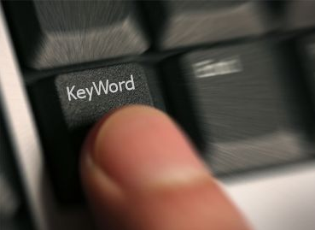
Keywords
In an electronic world, keywords determine whether your article is found or not!
Avoid making them
too general (“drug delivery”, “mouse”, “disease”, etc.)
too narrow (so that nobody will ever search for it)
Effective approach:
Look at the keywords of articles relevant to your manuscript
Play with these keywords, and see whether they return relevant papers, neither too many nor too few

Slide 52
Abstract
Tell readers what you did and the important findings
One paragraph (between 50-250 words) often, plus Highlight bullet points
Advertisement for your article
A clear abstract will strongly influence if your work is considered further
What has been done
Graphite intercalation compounds (GICs) of composition CxN(SO2CF3)2 · δF are prepared under ambient conditions in 48% hydrofluoric acid, using K2MnF6 as an oxidizing reagent. The stage 2 GIC product structures are determined using powder XRD and modeled by fitting one dimensional electron density profiles.
A new digestion method followed by selective fluoride electrode elemental analyses allows the determination of free fluoride within products, and the compositional x and δ parameters are determined for reaction times from 0.25 to 500 h.
What are the main findings
Notes:
The abstract should just be one paragraph and should summarize the problem, the method, the results, and the conclusions.
The abstract acts as an advertisement for you article since it is freely viewable via search and indexing. You want to make it as catchy and impactful as possible.
An abstract written clearly will strongly encourage the reader to read the rest of your paper.
An example of an abstract is given here and is shown with the two distinct sections that are most important. Different journals have different requirements for the content of abstract. (Again, consult the Guide for Authors. ) But the two “whats” are essential. Make it interesting, and easy to understand without reading the whole article (avoid using jargon and uncommon abbreviations if possible)
Note that some journals ask for a graphical abstract.
Many authors write the abstract last so that it accurately reflects the content of the paper.

Slide 53

Introduction
The place to convince readers that you know why your work is relevant, also for them
Answer a series of questions:
  What is the problem?
  Are there any existing solutions?
  Which one is the best?
  What is its main limitation?
  What do you hope to achieve?
General
Specific

Slide 54
Pay attention to the following
Before you present your new data, put them into perspective first
Be brief, it is not a history lesson
Do not mix introduction, results, discussion and conclusions. Keep them separate
Do not overuse expressions such as “novel”, “first time”, “first ever”, “paradigm shift”, etc.
Cite only relevant references
  Otherwise the editor and the reviewer may think you don’t have a clue where you are writing about

Slide 55
Methods / Experimental
Include all important details so that the reader can repeat the work.
  Details that were previously published can be omitted but a general summary of those experiments should be included
Give vendor names (and addresses) of equipment etc. used
All chemicals must be identified
  Do not use proprietary, unidentifiable compounds without description
Present proper control experiments
Avoid adding comments and discussion.
Write in the past tense
  Most journals prefer the passive voice, some the active.
Consider use of Supplementary Materials
  Documents, spreadsheets, audio, video, .....
Reviewers will criticize incomplete or incorrect descriptions, and may even recommend rejection

Slide 56
Ethics Committee approval
Experiments on humans or animals must follow applicable ethics standards
  e.g. most recent version of the Helsinki Declaration and/or relevant (local, national, international) animal experimentation guidelines
Approval of the local ethics committee is required, and should be specified in the manuscript
Editors can make their own decisions as to whether the experiments were done in an ethically acceptable manner
  Sometimes local ethics approvals are way below internationally accepted standards

Slide 57
Results – what have you found?
The following should be included
  the main findings
    Thus not all findings
    Findings from experiments described in the Methods section
  Highlight findings that differ from findings in previous publications, and unexpected findings
  Results of the statistical analysis

Slide 58
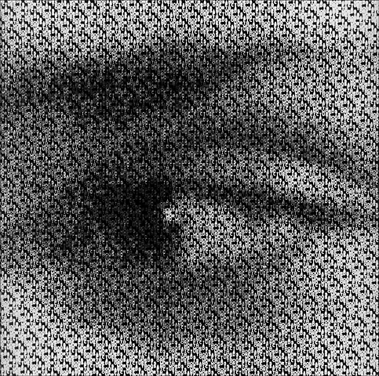
Results – Figures and tables
Illustrations are critical, because
  Figures and tables are the most efficient way to present results
  Results are the driving force of the publication
  Captions and legends must be detailed enough to make figures and tables self-explanatory
  No duplication of results described in text or other illustrations
"One Picture is Worth a Thousand Words"
Sue Hanauer (1968)

Slide 59
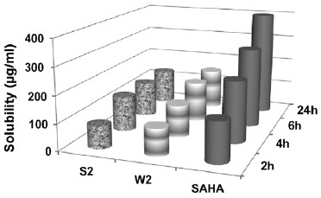
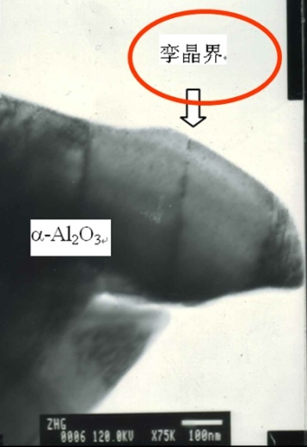
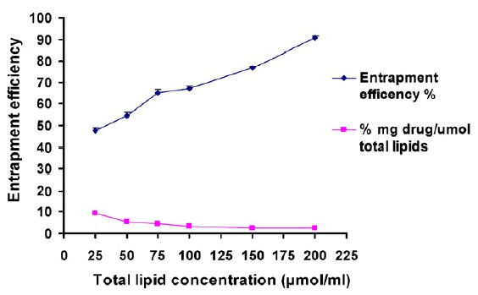
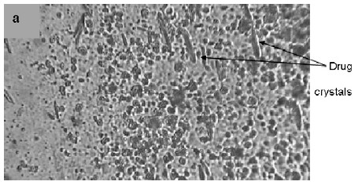
Results – Appearance counts!
  Un-crowded plots
    3 or 4 data sets per figure; well-selected scales; appropriate
    axis label size; symbols clear to read; data sets easily distinguishable.
  Each photograph must have a scale marker
  of professional quality in a corner.
  Text in photos / figures in English
    Not in French, German, Chinese, Korean, ...
  Color must be visible and distinguishable
  when printed in black & white.
  Do not include long boring tables!

Slide 60
Discussion – what do the results mean?
It is the most important section of your article. Here you get the chance to SELL your data!
  Many manuscripts are rejected because the Discussion is weak
Check for the following:
  How do your results relate to the original question or objectives outlined in the Introduction section?
  Do you provide interpretation for each of your results presented?
  Are your results consistent with what other investigators have reported? Or are there any differences? Why?
  Are there any limitations?
  Does the discussion logically lead to your conclusion?
Do not
  Make statements that go beyond what the results can support
  Suddenly introduce new terms or ideas

Slide 61
Conclusions
Present global and specific conclusions
Indicate uses and extensions if appropriate
Suggest future experiments and indicate whether they are underway
Do not summarize the paper (The abstract is for that purpose)
Avoid judgments about impact

Slide 62
References: Get them right!
Please adhere to the Guide for Authors of the journal
It is your responsibility, not of the Editor’s, to format references correctly!
Check
  Referencing style of the journal
  The spelling of author names, the year of publication
  Punctuation use
  Use of “et al.”: “et al.” translates to “and others”,
Avoid citing the following if possible:
  Personal communications, unpublished observations, manuscripts not yet accepted for publication
    Editors may ask for such documents for evaluation of the manuscripts
  Articles published only in the local language, which are difficult for international readers to find

Slide 63
Supplementary Material
Data of secondary importance for the main scientific thrust of the article
  e.g. individual curves, when a representative curve or a mean curve is given in the article itself
Or data that do not fit into the main body of the article
  e.g. audio, video, ....
Not part of the printed article
  Will be available online with the published paper
Must relate to, and support, the article

Slide 64
Typical length of a full article
Not the same for all journals, even in the same field
“…25- 30 pages is the ideal length for a submitted manuscript, including ESSENTIAL data only.”
  Title page
  Abstract 1 paragraph
  Introduction 1.5-2 manuscript pages (double-spaced, 12pt)
  Methods 2-4 manuscript pages
  Results & Discussion 10-12 manuscript pages
  Conclusions 1-2 manuscript pages
  Figures 6-8
  Tables 1-3
  References 20-50
  Letters or short communications usually have a stricter size limitation, e.g. 3,000 words and no more than 5 figures/tables.

Slide 65
Abbreviations
Abbreviations must be defined on the first use in both abstract and main text.
Some journals do not allow the use of abbreviations in the abstract.
Abbreviations that are firmly established in the field do not need to be defined, e.g. DNA.
Never define an abbreviation of a term that is only used once.
Avoid acronyms, if possible
  Abbreviations that consist of the initial letters of a series of words
  Can be typical “lab jargon”, incomprehensible to outsiders

Slide 66
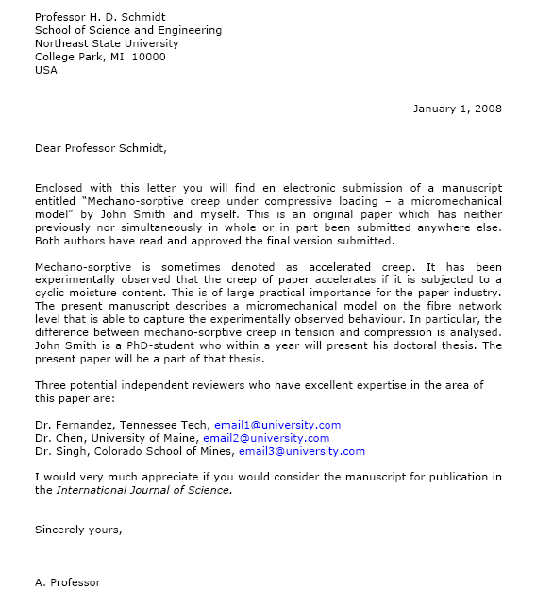
Cover Letter
Your chance to speak to the editor directly
Submitted along with your manuscript
Mention what would make your manuscript special to the journal
Note special requirements (suggest reviewers, conflicts of interest)
Final approval from all authors
Explanation of importance of research
Suggested reviewers
Notes:
The cover letter offers you a chance to correspond directly with the journal editor. Many editors won’t reject a manuscript only because the cover letter is bad. However, a good cover letter may accelerate the editorial process of your paper.
It is submitted along with your manuscript.
You want to mention what would make your manuscript special or worthwhile to the journal. Do not summarize your manuscript, or repeat the abstract. You should mention why your manuscript is original and what your purpose is. Your letter should also state the final approval of all co-authors as well as if your manuscript has been previously rejected.
Consider mentioning other special requirements such as conflicts of interest, suggested reviewers, people who should not review.

Slide 67
What not to do: Publishing Ethics
When it comes to publishing ethics abuse, the much used phrase “Publish or Perish” has in reality become “Publish and Perish”!

Slide 68
Ethics Issues in Publishing
Scientific misconduct
  Falsification of results
Publication misconduct
  Plagiarism
    Different forms / severities
    The paper must be original to the authors
  Duplicate publication
  Duplicate submission
  Appropriate acknowledgement of prior research and researchers
  Appropriate identification of all co-authors
  Conflict of interest

Slide 69
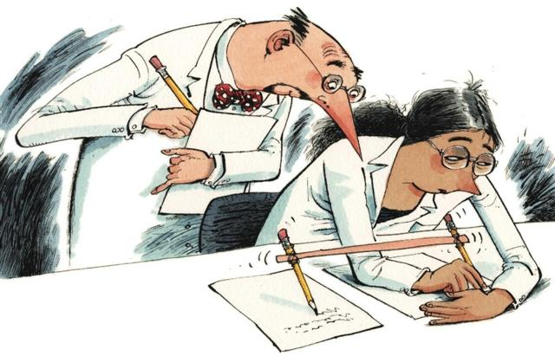
Publish and perish! – If you break ethical rules
International scientific ethics have evolved over centuries and are commonly held throughout the world.
Scientific ethics are not considered to have national variants or characteristics – there is a single ethical standard for science.
Ethics problems with scientific articles are on the rise globally.
M. Errami & H. Garner
A tale of two citations
Nature 451 (2008): 397-399

Slide 70
Data fabrication and falsification
Fabrication: Making up data or results, and recording or reporting them
“… the fabrication of research data … hits at the heart of our responsibility to society, the reputation of our institution, the trust between the public and the biomedical research community, and our personal credibility and that of our mentors, colleagues…”
“It can waste the time of others, trying to replicate false data or designing experiments based on false premises, and can lead to therapeutic errors. It can never be tolerated.”
Professor Richard Hawkes
Department of Cell Biology and Anatomy
University of Calgary
“The most dangerous of all falsehoods is a slightly distorted truth.”
G.C.Lichtenberg (1742-1799)

Slide 71
Data fabrication and falsification
Falsification:
Manipulation of research materials, equipment, processes
Changes in / omission of data or results such that the research is not accurately represented in the research record
“Select data to fit a preconceived hypothesis:
  We do not include (data from) an experiment because ‘it did not work’, or
  We show ‘representative’ images that do not reflect the total data set, or
  We simply shelve data that do not fit.”
  Richard Hawkes

Slide 72
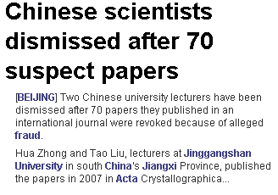
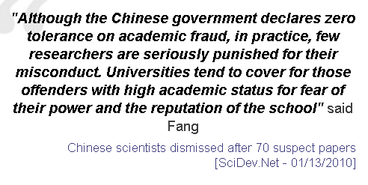
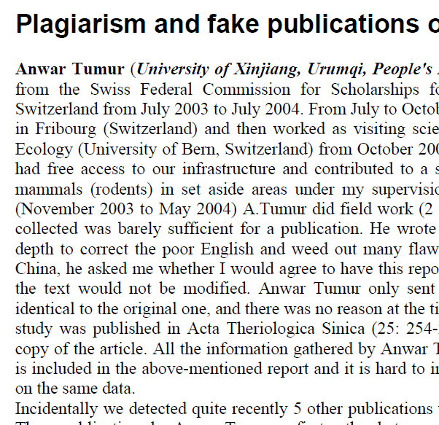
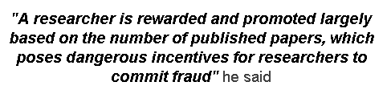
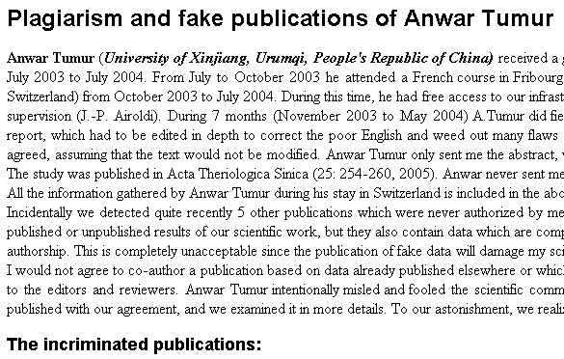
Data Fabrication & Falsification - often go hand in hand
A Massive Case Of Fraud
Chemical & Engineering News
February 18, 2008
Journal editors are left reeling as publishers move to rid their archives of scientist's falsified research
William G. Schulz
A CHEMIST IN INDIA has been found guilty of plagiarizing and/or falsifying more than 70 research papers published in a wide variety of Western scientific journals between 2004 and 2007, according to documents from his university, copies of which were obtained by C&EN. Some journal editors left reeling by the incident say it is one of the most spectacular and outrageous cases of scientific fraud they have ever seen.

Slide 73

Plagiarism
A short-cut to long-term consequences!
Plagiarism is considered a serious offense by your institute, by journal editors, and by the scientific community.
Plagiarism may result in academic charges, but will certainly cause rejection of your paper.
Plagiarism will hurt your reputation in the scientific community.

Slide 74
Duplicate publication
Two or more papers, without full cross reference, share the same hypotheses, data, discussion points, or conclusions
An author should not submit for consideration in another journal a previously published paper.
  Published studies do not need to be repeated unless further confirmation is required.
  Previous publication of an abstract during the proceedings of conferences does not preclude subsequent submission for publication, but full disclosure should be made at the time of submission.
  Re-publication of a paper in another language is acceptable, provided that there is full and prominent disclosure of its original source at the time of submission.
  At the time of submission, authors should disclose details of related papers, even if in a different language, and similar papers in press.
  This includes translations

Slide 75

Plagiarism Detection Tools
Elsevier is participating in 2 plagiarism detection schemes:
  TurnItIn (aimed at universities)
  IThenticate (aimed at publishers and corporations)
Manuscripts are checked against a database of 20 million peer reviewed articles which have been donated by 50+ publishers, including Elsevier.
All post-1994 Elsevier journal content is now included, and the pre-1995 is being steadily added week-by-week
Editors and reviewers
Your colleagues
"Other“ whistleblowers
  “The walls have ears", it seems ...

Slide 76
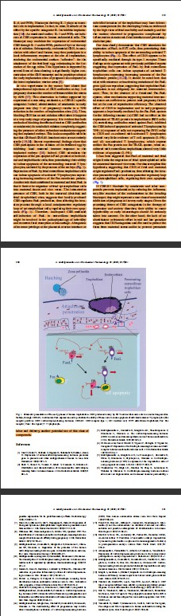
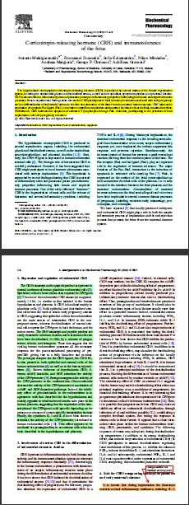
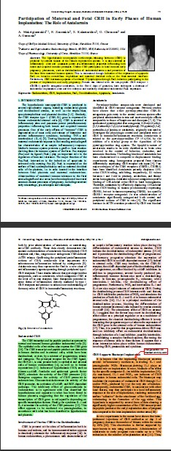
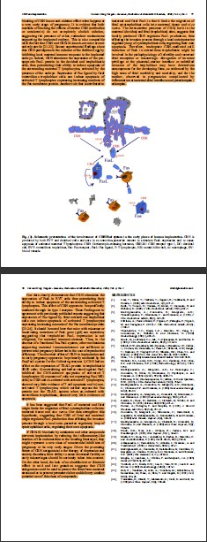
Publication ethics – Self-plagiarism
2003
2004
Same colour left and right
Same text

Slide 77

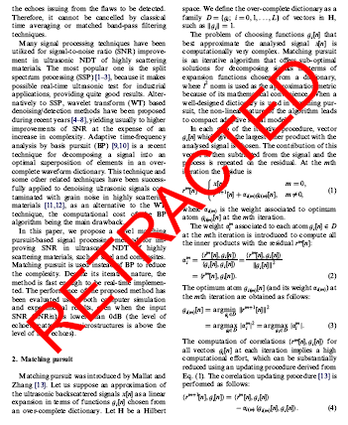
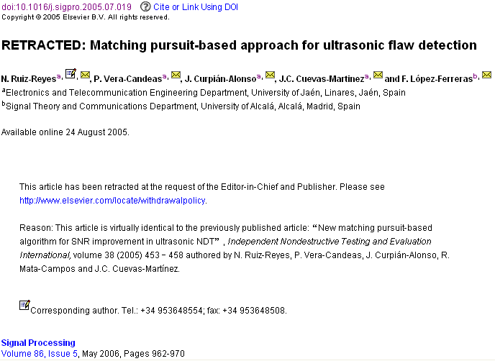
An article in which the authors committed plagiarism: it will not be removed from ScienceDirect ever. Everybody who downloads it will see the reason for the retraction…

Slide 78

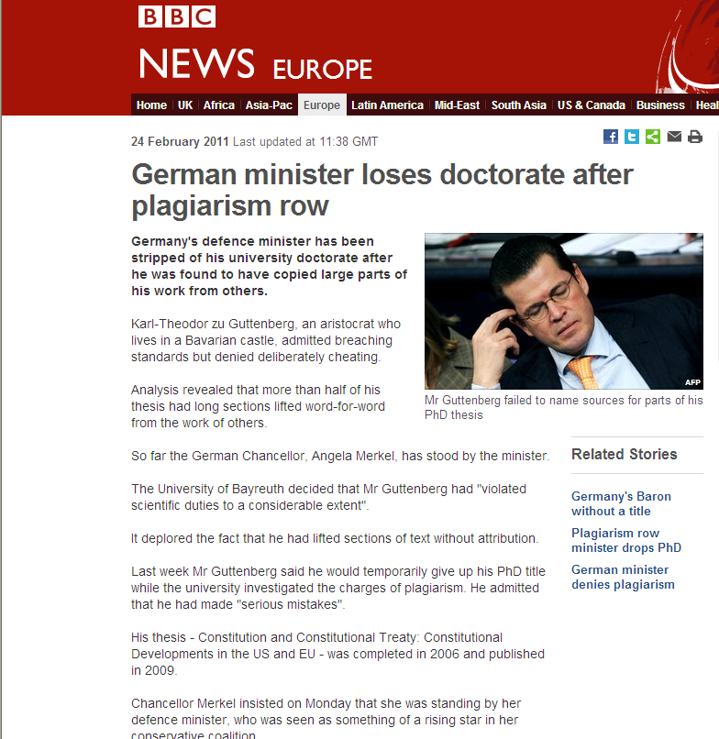
Publication ethics – How it can end .....

Slide 79
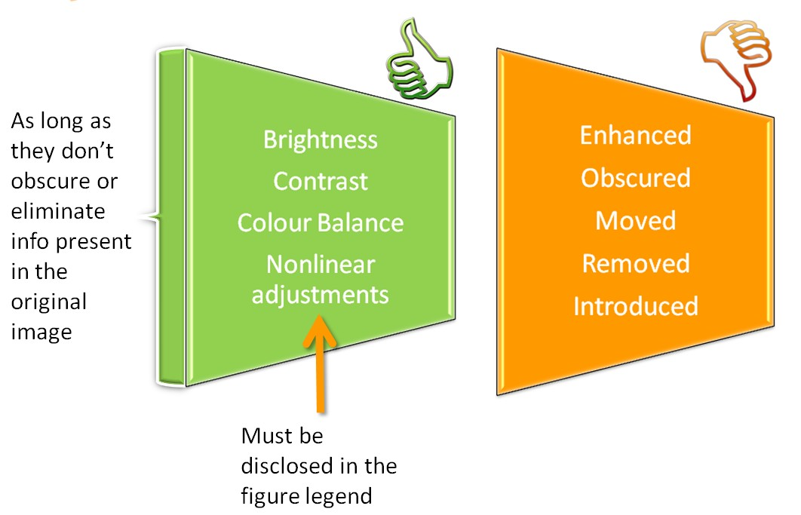
Figure Manipulation – some things are allowed

Slide 80

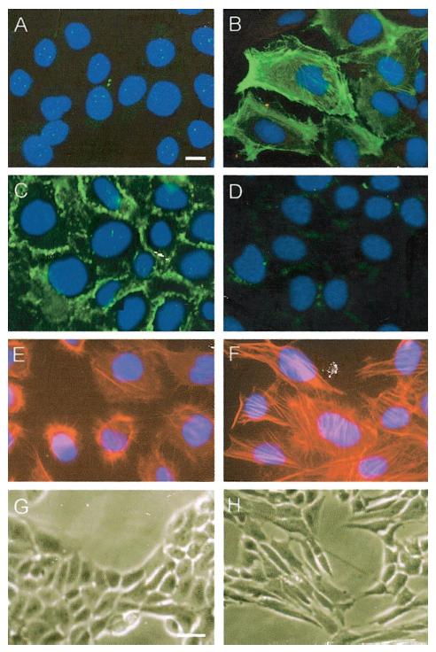
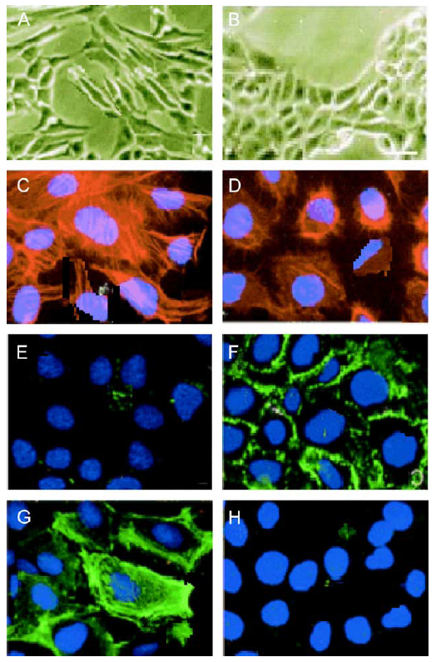
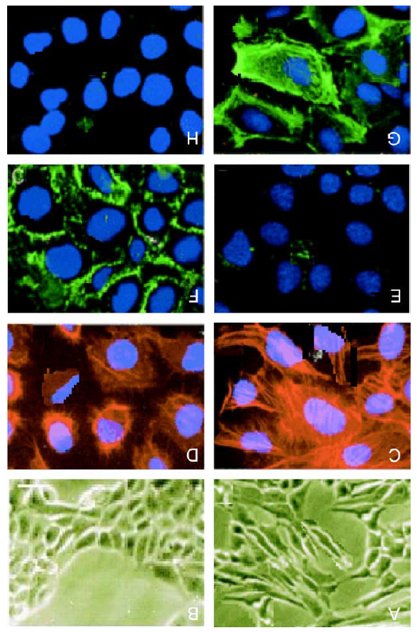
Figure manipulation
Example - Different authors and reported experiments
Am J Pathol, 2001
Life Sci, 2004
Life Sci, 2004
Rotated 180º
Rotated 180º
Zoomed out ?!

Slide 81
The Peer Review Process

Slide 82
Purpose of Peer Review
Check the manuscript for
Mistakes in procedures or logic
Conclusions not supported by the results
Errors or omissions in the references
Compliance with ethics standards
  Has the protocol been approved by an appropriate Ethics Committee?
    Animal research: e.g. “Guiding Principles in the Care and Use of Laboratory Animals”
    Human research: Most recent “Declaration of Helsinki”
Originality and significance of the work

Slide 83

Suggest potential reviewers
Your suggestions will help the Editor to move your manuscript to the review stage more efficiently.
You can easily find potential reviewers and their contact details from articles in your specific subject area (e.g., your references).
The reviewers should represent at least two regions of the world. And they should not be your supervisor or close friends.
Be prepared to suggest 3 -6 potential reviewers, based on the Guide to Authors.

Slide 84
Do everything to make your submission a success
No one gets it right the first time!
  Write, and re-write ….
Suggestions
  After writing a first version, take several days of rest. Come back with a critical, fresh view.
  Ask colleagues and supervisor to review your manuscript. Ask them to be highly critical, and be open to their suggestions.

Slide 85
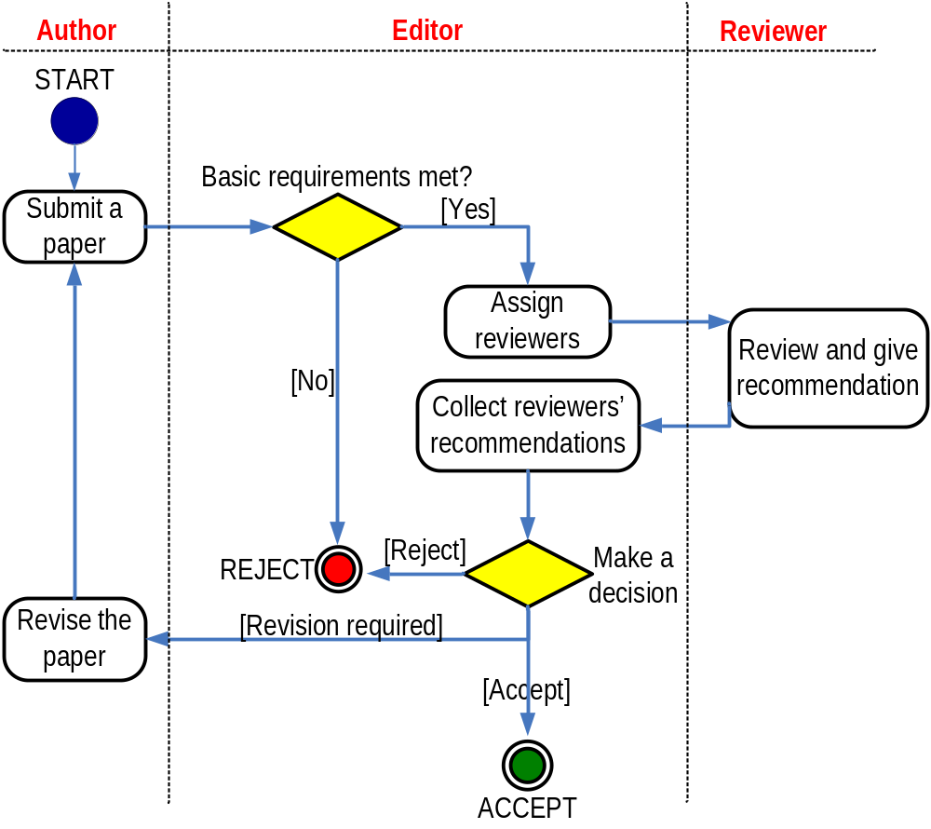
The Peer Review Process – not a black hole!
Michael Derntl. Basics of Research Paper Writing and Publishing. http://www.pri.univie.ac.at/~derntl/papers/meth-se.pdf
Notes:
85
Do no hang on there too long. We will explain these three main points in the coming slides.

Slide 86
Privileged Document
A manuscript is a confidential document. The data
Are and remain the exclusive property of the authors
Should not be disclosed to others (who may use the information in their research)
If a reviewer has printed the manuscript
It must be kept confidential until the review process has been completed
After final decision by the editor it must be destroyed
If a reviewer has shared responsibility for the review of a manuscript with a colleague, they should provide that person’s name and affiliation to the editors

Slide 87
Review Process
Regular articles are initially reviewed by at least two reviewers
When invited, the reviewer receives the Abstract of the manuscript
The editor generally requests that the article be reviewed within reasonable time (varies per field), limited extensions sometimes acceptable
Articles are revised until the two reviewers agree on either acceptance or rejection, or until the editor decides that the reviewer comments have been addressed satisfactorily
The reviewers’ reports help the Editors to reach a decision on a submitted paper
The reviewer recommends; the editor decides!

Slide 88
Review Process (ii)
If a report has not been received in good time, the Editorial office contacts the reviewer
If there is a notable disagreement between the reports of the reviewers, a third reviewer may be consulted
The anonymity of the reviewers is strictly maintained
Unless a reviewer asks to have his/her identity made known to the authors

Slide 89

Review Process (iii)
Reviewers do not communicate directly
with authors
As author
As editor
As reviewer
All manuscripts and supplementary material must be treated confidentially by editors and reviewers
  The manuscript cannot be distributed outside this small group
As reader
The aim is to have a “first decision” to the authors as fast as possible after submission of the manuscript
Meeting these schedule objectives requires a
significant effort on the part of the Editorial staff,
Editor and Reviewers
As a researcher,
you wear many hats!
If reviewers treat authors as they themselves would like to be treated as authors, then these objectives can be met

Slide 90

Initial Editorial Review
Many journals use a system of initial editorial review. Editors may reject a manuscript without sending it for review
Why?
The peer-review system is grossly overloaded and editors wish to use reviewers only for those papers with a good probability of acceptance.
It is a disservice to ask reviewers to spend time on work that has clear and evident deficiencies.

Slide 91
Rejection without External Review
The Editor-in-chief evaluates all submissions, and determines whether they go into the review process
or are rejected by the editor
Criteria
Example – “Rules-of-Three” in the European Journal of Pharmaceutics and Biopharmaceutics
  Out of scope
  Too preliminary
  Lack of Novelty
English language is inadequate
Prior publication of (part of) the data
Multiple simultaneous submissions of same data
Etc.,
each with specific examples
Notes:
INSERT DISCIPLINE-SPECIFIC CRITERIA HERE. EXAMPLE SHOWN HERE IS THE European Journal of Pharmaceutics and Biopharmaceutics

Slide 92

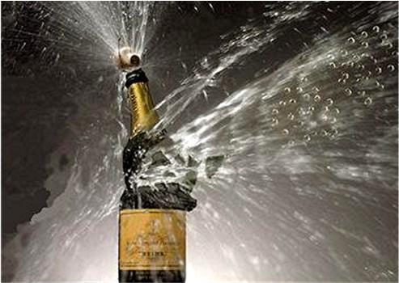
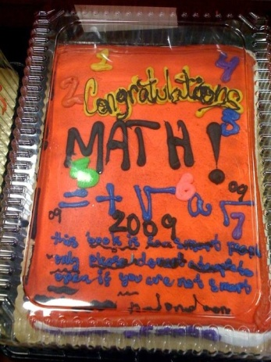
First Decision: “Accepted” or “Rejected”
Accepted
Very rare, but it happens
Congratulations!
  Cake for the department
  Now wait for page proofs and then for your article to be online (and in print)
Rejected
Probability 40-90% ...
Do not despair
  It happens to everybody
Try to understand WHY
  Consider reviewers’ advice
  Be self-critical
If you submit to another journal, begin as if it were a new manuscript
  Take advantage of the reviewers’ comments
  They may review your manuscript for the other journal too
  Read the Guide for Authors of the new journal, again and again.

Slide 93



Reviewers look at:
Importance and clarity of research hypothesis
Originality of work
Delineation of strengths and weaknesses of methodology, experimental / statistical approach, interpretation of results
Writing style and figure / table presentation
Ethics concerns (animal / human)
“ Novelty”
“ Technical” Quality

Slide 94
Quality of the work
Are the methods appropriate and presented in sufficient detail to allow the results
to be repeated?
Are the data adequate to support the conclusions?
Methods
Results
Conclusions
Do all “methods” have a “results”?
Have all “results” been described in the “Methods”?
Are all “conclusions” based on “results”?

Slide 95

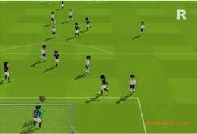

Reviewer comments to the Editors
Comment on novelty and significance
Recommend whether the manuscript is suitable for publication or not, usually
  Accept / Minor revision / Major Revision / Reject
Reviewer makes a
recommendation
Editor makes
the decision
Confidential comments will not be disclosed to author(s)!

Slide 96
Reviewer Checklist
Confidential checklist meant for editor’s eyes only
Rating Scale
Top 10%____Top 25% ____ Top 50%_____ Lower 50%____ For each of Experimental Design, Data Quality, Originality, Overall priority
Manuscript Length
OK ______ E(xpand) ______ S(horten) ______
For each of Abstract, Introduction, Methods, Results, Discussion, References
Recommen-dation to editor
Accept / Minor revision / Major Revision / Reject
Notes:
European Journal of Pharmaceutical Sciences Reviewer Checklist
INSERT CHECKLIST FOR OWN DISCIPLINE IF PLANNING TO USE

Slide 97
Reviewer Checklist
Confidential checklist meant for editor’s eyes only
Yes
No
Is the article within the scope of the journal?
Would the article be more appropriately published in a specialist journal?
Can the article be condensed?
If so, where: Figures Figure legends Tables Text
Is the language acceptable?
Are there portions of the manuscripts which require further clarification?
If so, where? ________________
On a scale from 1 (poor) to 5 (outstanding), how do you rate
Novelty, New knowledge in xyz
Experimental design
Evaluation of data
Discussion of results
Clarity of presentation
Poor
1
2
3
4
5
Outstanding
The article should be
Accepted without change
Accepted after minor revision
Accepted after condensation
Reconsidered after major revision
Rejected
Confidential comments to the editor: [free text]
Notes:
INSERT CHECKLIST EXAMPLE FROM OWN DISCIPLINE IF PLANNING TO USE

Slide 98
What can you get back from peer review?
Accepted without change (very rare!)
Accepted after minor revision (means you will have to change a few things)
Accepted after consideration (means you will have to rewrite a few things, possibly sections, figures, provide more data, etc)
Reconsider after mayor revision (means you will have to dares some fundamental shortcomings – possibly doing additional research and certainly rewriting big sections)
Rejection (means the manuscript is not deemed suitable for publication in that journal)

Slide 99
Reviewer comments to Authors
Provides specific comments on the design, presentation of data, results, and discussion
  Do not include recommendations for acceptance / rejection
Reviewers should ensure that that the comments to the author(s) are consistent with recommendations to the editors

Slide 100
Manuscript Revision
Prepare a detailed Response Letter
  Copy-paste each reviewer comment, and type your response below it
  State specifically which changes you have made to the manuscript
    Include page/line numbers
    No general statements like “Comment accepted, and Discussion changed accordingly.”
  Provide a scientific response to comments to accept, .....
  ..... or a convincing, solid and polite rebuttal when you feel the reviewer was wrong.
  Write in such a manner, that your response can be forwarded to the reviewer without prior editing
Do not do yourself a disfavour, but cherish your work
  You spent weeks and months in the lab or the library to do the research
  It took you weeks to write the manuscript.........
.....Why then run the risk of avoidable rejection
by not taking manuscript revision seriously?

Slide 101
Increasing the likelihood of acceptance
All these various steps are not difficult
You have to be consistent.
You have to check and recheck before submitting.
Make sure you tell a logical, clear, story about your findings.
Especially, take note of referees’ comments.
This should increase the likelihood of your paper being accepted, and being in the 30% (accepted) not the 70% (rejected) group!

Slide 102
What leads to acceptance ?
Attention to details
Check and double check your work
Consider the reviewers’ comments
English must be as good as possible
Presentation is important
Take your time with revision
Acknowledge those who have helped you
New, original and previously unpublished
Critically evaluate your own manuscript
Ethical rules must be obeyed
– Nigel John Cook
Editor-in-Chief, Ore Geology Reviews

Slide 103
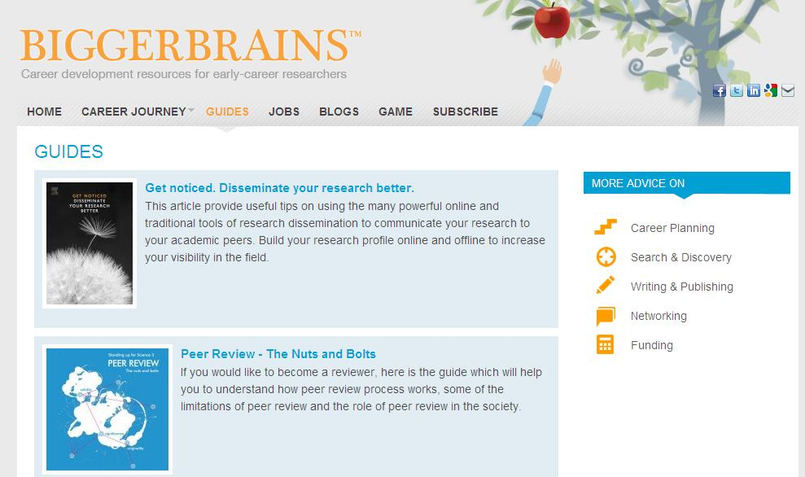
There are lots of online resources....
Elsevier and many other publishers give lots of helpful advice, as do many scientific societies and universities – go look!

Slide 104

Article of the Future
here

Slide 105
References and Acknowledgements
Guide for Authors of Elsevier journals.
http://owl.english.purdue.edu/owl/
http://www.physics.ohio-state.edu/~wilkins/writing/index.html
Petey Young. Writing and Presenting in English. The Rosetta Stone of Science. Elsevier 2006
EDANZ Editing training materials. 2006
Jullian Eastoe. Co-editor, Journal of Colloid and Interface Science
Peter Thrower. Editor-in-chief, Carbon
Roel Prins. Editor-in-chief, Journal of Catalysis
Nigel Cook. Editor-in-chief, Ore Geology Reviews.
Frans P. Nijkamp, Journal of Ethnopharmacology
Wilfred CG Peh. Editor, Singapore Medical Journal
Malcolm W. Kennedy. Professor, Institue of Biomedical and Life Sciences, University of Glasgow, UK
Notes:
This page will be finished after I revised the whole manuscript. In the first draft only names are provided.
Please help to copy edit this page…Thanks!!!

Slide 106
Further reading for you
Mark Ware Consulting Ltd, Publising and E-learning Consultancy. Scientific publishing in transition: an overview of current developments. Sept., 2006. www.stm-assoc.org/storage/Scientific_Publishing_in_Transition_White_Paper.pdf
Ethical Guildlines for Journal Publishing, Elsevier. http://www.elsevier.com/wps/find/intro.cws_home/ethical_guidelines#Duties%20of%20Authors
International Committee of Medical Journal Editors. Uniform Requirements for Manuscripts Submitted to Biomedical Journals: Writing and Editing for Biomedical Publication. Feb. 2006
http://www.publicationethics.org.uk/guidelines
http://www.icmje.org/index.html#ethic
http://www.onlineethics.org/
http://owl.english.purdue.edu/owl/
http://www.physics.ohio-state.edu/~wilkins/writing/index.html
George D. Gopen, Judith A. Swan. The science of Scientific Writing. American Scientist (Nov-Dec 1990), Vol. 78, 550-558.
Michael Derntl. Basics of Research Paper Writing and Publishing.
http://www.pri.univie.ac.at/~derntl/papers/meth-se.pdf
Thomas H Adair. Professor, Physiology & Biophysics Center of Excellence in Cardiovascular-Renal Research, University of Mississippi Medical Center. http://dor.umc.edu/ARCHIVES/WritingandpublishingaresearcharticleAdair.ppt
Bruce Railsback. Professor, Department of Geology, University of Georgia. Some Comments on Ethical issues about research. www.gly.uga.edu/railsback/11111misc/ResearchEthics.html
Peter Young. Writing and Presenting in English. The Rosetta Stone of Science. Elsevier 2006.
Philip Campbell. Editor-in-Chief, Nature. Futures of scientific communication and outreach. June 2007.
Yaoqi ZHOU. Recipe for a quality Scientific Paper: Fulfill Readers’ and Reviewers’ Expectations. http://sparks.informatics.iupui.edu
EDANZ Editing training materials. 2006 http://liwenbianji.com, http://www.edanzediting.com/english.html
Anthony Newman, Ethics White Paper http://www.ifcc.org/media/161822/IFCC%20Ethics%20in%20Science.pdf

Slide 107

Thank you!
Or for questions later, please contact m.lamine@elsevier.com

