Slide 1
Flourishing Communities: A new model to promote sustainable community leadership and transformation in semi-rural Kenya
Community and Social Impact Statement
Michael L. Goodman, Linda Theron, Sarah Seidel, Aleisha Elliott, Lauren Raimer-Goodman, Philip Keiser, Stanley Gitari & Christine Gatwiri

Slide 2
What do we do about children living on the streets of Kenya?
What do we do about many different challenges that face communities globally?
How do we avoid defining communities by what they have going wrong, but rather by how they envision or could envision their growth?
How do we support community self-organization and leadership so they can achieve their own goals and pursue their own values?

Slide 3
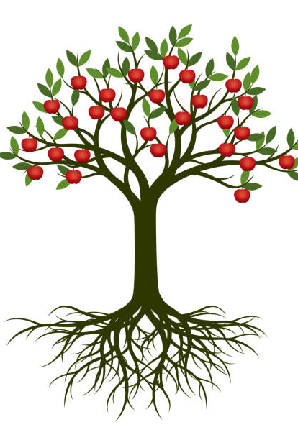
Flourishing communities Model
Layer 5: Tell new success stories, improve norms & share gains with others
Layer 4: Improve sector-specific outcomes
Dynamic, compassionate, responsive, assertive, self-determining, resilient, productive, loving, informed, curious, role-model, generative communities
Layer 3: Resolve trauma & depression, build positivity
Layer 2: Build social capital via shared material good
Layer 1: Inclusion & Reconciliation

Slide 4
Process:
Bring
Bring members together, especially those who are excluded
Build
Build economic resources through investing in and developing social cohesion, trust, and collective efficacy among members
Help
Help resolve sources of trauma and depression; work to build positive resources – hope, meaning in life, positive emotions, values-clarity, curiosity, and compassion
Connect
Connect demand for change with resources – knowledge, partners, financing, etc. – in ways supporting and responsive to community leadership
Identify and celebrate
Identify and celebrate new successes; share potential for change with other communities

Slide 5
This study adds…
Support for theoretical connections linking community-led development, multisystemic resilience and the “broaden-and-build” cycle of attachment processes
Support for the social psychological mechanisms of the broader “flourishing community” model

