Slide 1

Copyright Presentation
By: The Copyright Officer: Zama Khanyile

Slide 2
Take outs from the presentation
• What is Copyright;
Who exactly is an author;
Works that can be protected;
Copyright infringement and its consequences;
The Difference Between Copyright Infringement and Plagiarism;
How much can you copy;
Exceptions for libraries;
Using internet & e-Resources;
Difference between subscriptions and open access;
License Agreements;
Open access;
Creative commons;
Fair dealing and
Sharing material through emails.
Copyright Compliance Presentation by Zama Khanyile: Copyright Officer

Slide 3

What is copyright?
Copyright is a type of intellectual property license that protects original works of authorship. It protects the expression of the work against infringement by other writers or entities.
A copyright is subject to limitations based on public interest considerations, such as the fair use,
In South Africa, copyright lasts a lifetime of the owner plus 50 after death.
Copyright Compliance Presentation by Zama Khanyile: Copyright Officer

Slide 4
Who exactly is an author &
who controls a copyright
An author is the writer of a book, article, play, or other written work – e.g. A photographer, painter, and sculptor.
A Person who gave exitance to anything,
Copyright Compliance Presentation by Zama Khanyile: Copyright Officer

Slide 5
Works that can be protected include:
Literary works
Artistic works
Published editions
Musical works
Films
Broadcasts
Computer programmes
Copyright Compliance Presentation by Zama Khanyile: Copyright Officer

Slide 6
Copyright Infringement vs Plagiarism
Copyright infringement is copying an extensive amount of work without the consent of the copyright owner.
The South African Copyright Act 98 of 1978 stipulates monetary and criminal penalties for infringements - This varies case by case
What is plagiarism?
“Plagiarism is the presentation of someone else’s work as you own work without properly acknowledging the source”.
This includes using words, images, ideas, artwork, music and websites whether published or not,
Copyright Compliance Presentation by Zama Khanyile: Copyright Officer

Slide 7
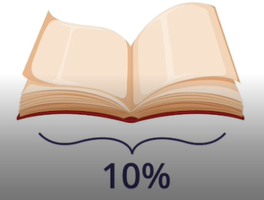
How much can you copy?
The copyright Act does not define the amount a user can copy for educational purposes however the book industry license allows a user to copy only up to 10% of a book or one full chapter for course pack material.
Should you require to use more then you are advised to buy the book or contact the publisher directly for permission.
Copyright Compliance Presentation by Zama Khanyile: Copyright Officer

Slide 8
Exceptions for libraries
Libraries may make a single copy for a student or lecturer
A library or archive may preserve or replace lost or damaged printed works, and share via inter-lending loans, unpublished and published printed works
What libraries may not do without permission
Scan or digitize material to place on open access repository
Format shift - Convert from old to new technologies
Send copyright works to users via email or usb stick
No digital document delivery service except for scanning to another library
There are no exceptions for museums and galleries or for orphan work
Copyright Compliance Presentation by Zama Khanyile: Copyright Officer

Slide 9

Difference between subscriptions and open access
Subscriptions: You need to pay to access the content
Open access: The material is openly available and free to use
Sharing material that the next person should be paying for is basically robbing the author from getting their financial benefits.
This Photo by Unknown Author is licensed under CC BY
Copyright Compliance Presentation by Zama Khanyile: Copyright Officer

Slide 10
License Agreements
Most Libraries have license agreements with different database companies for us to be able to access material online through subscriptions.
Most, if not all, license agreements have clauses on what users are and are not allowed to do with the licensed material they access.
This includes prohibiting any form of copyright infringement, as well as that no copyright notices may be removed, covered or modified in any way.
The licenses usually state that all copyrights and intellectual property rights relating to the licensed material are the sole and exclusive property of the Publisher or Third Party Licensor.
Copyright Compliance Presentation by Zama Khanyile: Copyright Officer

Slide 11
Using internet & e-Resources
Access may be free while coping, reproducing or adapting may not be
Always check the online or website copyright policy
Government websites are copyrighted but the material can be used for non-commercial purposes
Always use the libraries resources first as they are reputable and paid for to use
Using Social Media
Be careful what you put on there as it stays on there permanently even when you delete remember the data does not get deleted so its like a backup somewhere.
Facebook and other social media platforms have a broad license to use your posts however they like.
Copyright Compliance Presentation by Zama Khanyile: Copyright Officer

Slide 12

Set of principles and practices for distributing research outputs online freely;
Open Access returns us to the values of science: to help advance and improve society by providing immediate and unrestricted access to the latest research;
These include all electronic platforms such as:
Directory of Open Access Journal (DOAJ)
Directory of Open Access Books (DOAB)
Directory of Open Access Repositories (DOAR)
Directory of Open Access Scholarly resources
Directory of Open Access Scholarly Resources
Project Gutenberg (out of copyright books)
Copyright Compliance Presentation by Zama Khanyile: Copyright Officer

Slide 13
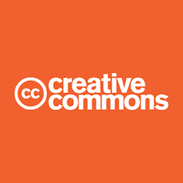
Creative Commons is a non-profit international organization that provides standardized ways to give the public permission to share and use creative work on conditions of the authors choice.
This simply changes the copyright terms from the default of “all rights reserved” to “some rights reserved.”
There are several different CC license types,
https://creativecommons.org/about/cclicenses/
Copyright Compliance Presentation by Zama Khanyile: Copyright Officer

Slide 14
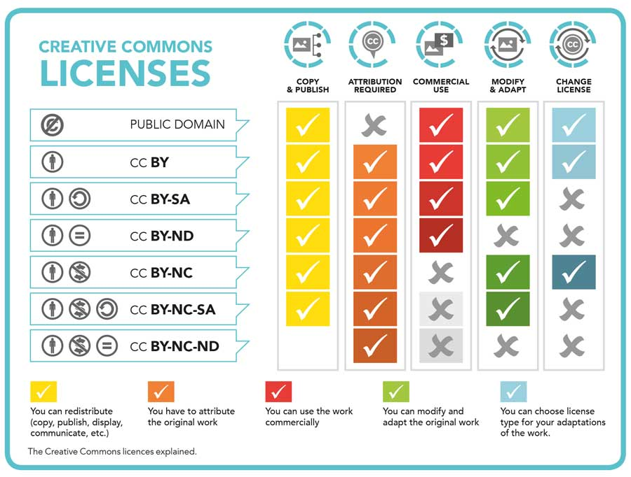
This Photo by Unknown Author is licensed under CC BY

Slide 15

Public Domain
https://www.iconspng.com/images/public-domain-logo/public-domain-logo.jpg
Public domain refers to creative materials that are not protected by intellectual property laws
Public domain content can be used freely, without paying any money or entering into any license agreement.
Copyright Compliance Presentation by Zama Khanyile: Copyright Officer

Slide 16

Fair Dealing
The fair dealing copyright section allows a user to copy, for their own study, research or private use, as much of the work as they need to meet their reasonable needs, without seeking permission from the copyright owner or paying compensation.
Researchers must give credit to the copyright holder
The use of the materials should be fair. There is no legal definition of what is fair or unfair; it is at the court’s discretion based on the individual facts of the case and the purpose for which the material is being used
Multiple copies are outside of fair dealing
Copyright Compliance Presentation by Zama Khanyile: Copyright Officer

Slide 17
Sharing material through emails
Sharing of pdf copies through emails is considered as an infringement of copyright.
An alternative is to share a direct link or permanent link to the reading from the website or database.
Copyright Compliance Presentation by Zama Khanyile: Copyright Officer

Slide 18

Copyright Compliance Presentation by Zama Khanyile: Copyright Officer

Slide 19
Copyright office
Merensky library Level 6 Room 33
Tel +27 (0)12 420 2056
Email: copyright@up.ac.za

