Slide 1















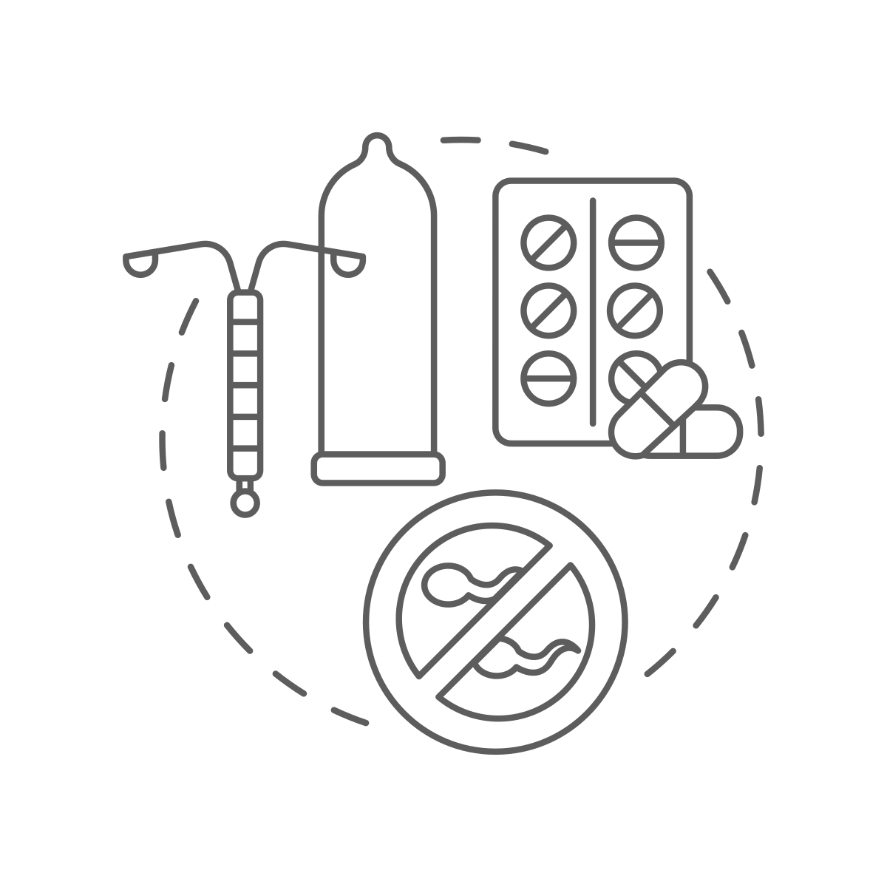


Pregnancy care for cancer survivors
Before pregnancy
Pregnancy care
Delivery planning
Postpartum care
Monitoring
Recurrence
and
restarting medication
Routine booking bloods
+ baseline labs
Detailed history past cancer
Aneuploidy screening
Serial US scans
Fetus
Thromboprophylaxis
Treatment past cancer (surgery, chemotherapy and radiation)
FIGO Nutrition checklist
Birth planning
Vaginal or caesarean
Obstetric anaesthetic assessment
Mental health
FIGO Preconception checklist
FIGO Nutrition checklist
Vaccine
prophylaxis
Contraception
Wait 1-2 years after completing cancer treatment
Monitoring recurrences
Breastfeeding and
infant nutrition
Mental health
Interdisciplinary teamwork

