Slide 1
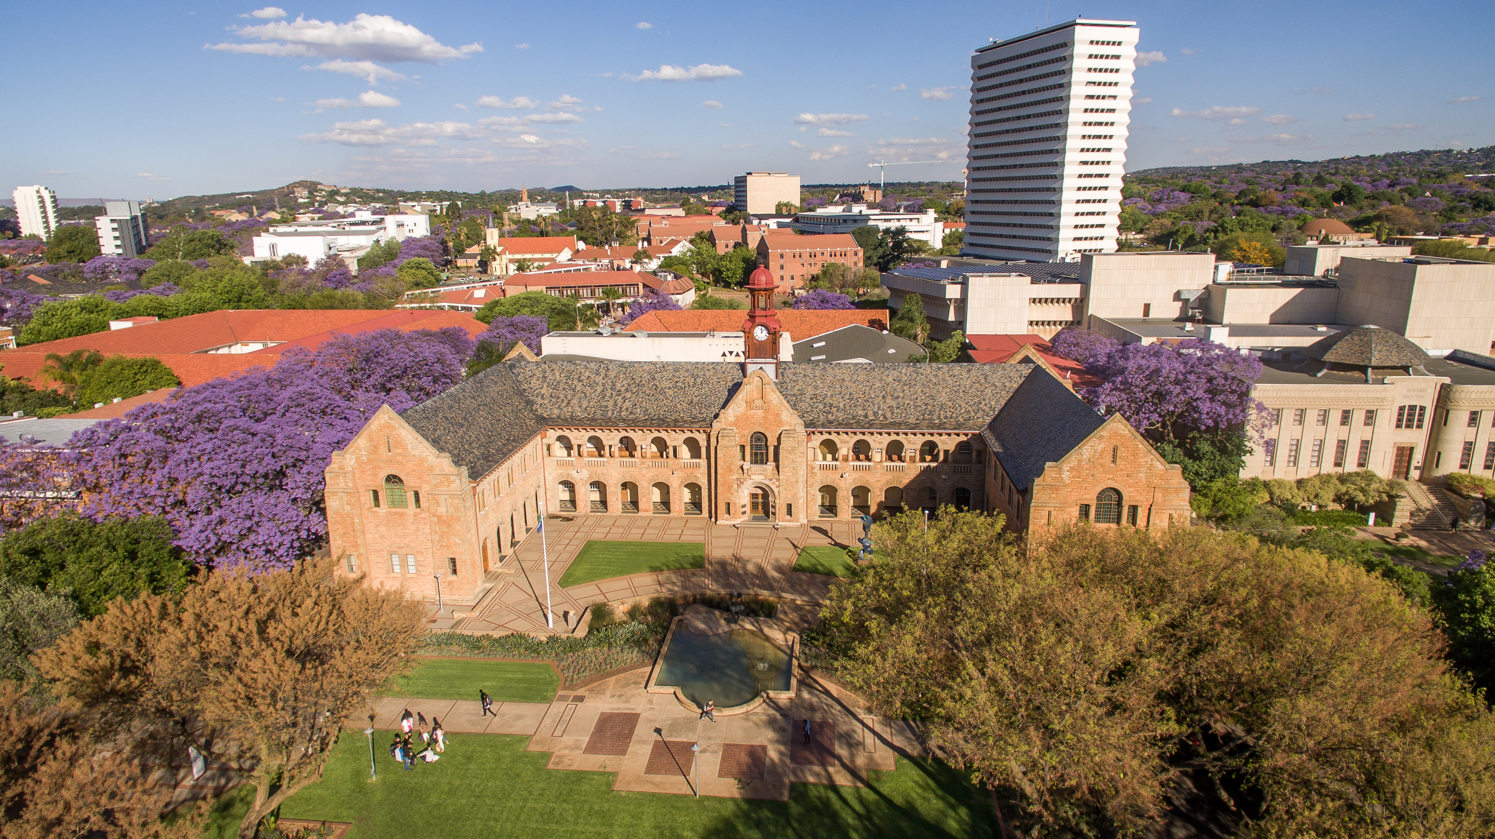

Formatting your article with MS Word
Early Career Academics and Postgraduate Workshop program
Presenter: Joseph Gozoya

Slide 2
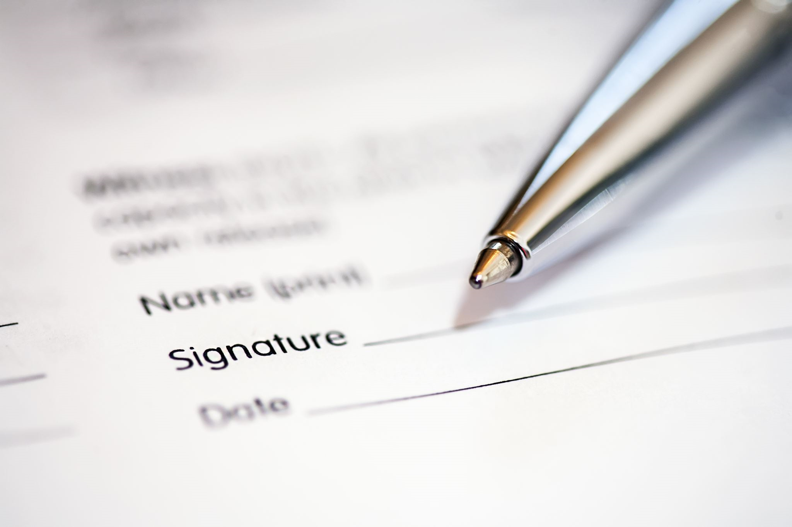
Microsoft Word
Easy to use word processing application
Further editing templates

Slide 3
Journal requirements
The structure and formatting
Format, style, and layout
Following guidelines is crucial for acceptance, publication, and time

Slide 4

Selected journals
Agriculture & applied economics
World Development

Slide 5
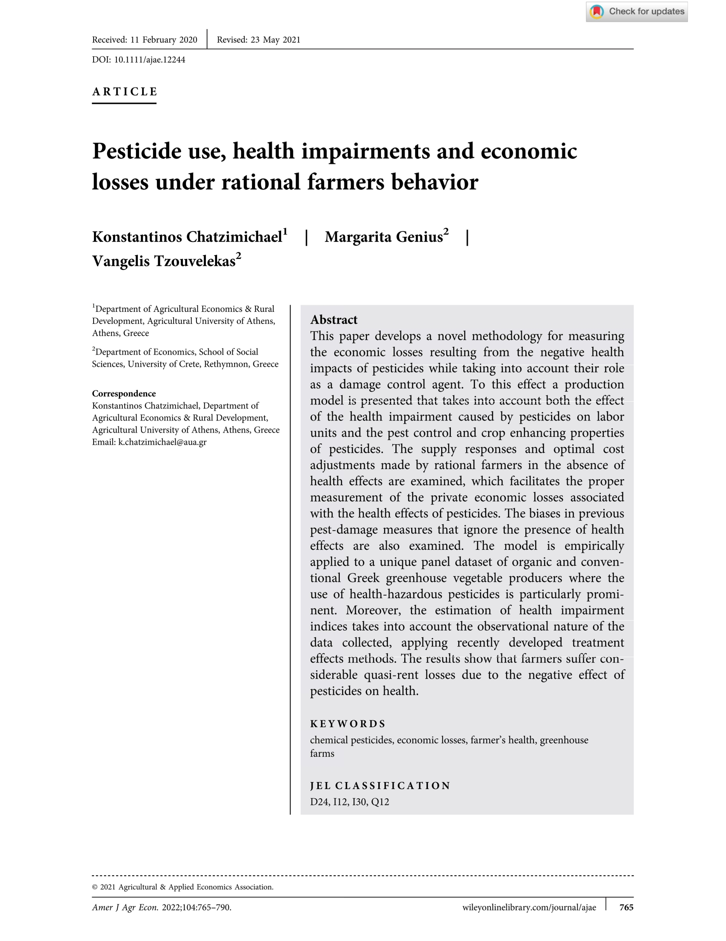
1

Slide 6
Demonstration using word
Save backup (Create copies)
Restructuring the writeup (footnotes, captions, paragraphs, names)
numbering (pages, titles, figs, equations)
Visuals (graphs, maps)
Equations (Models, Illustrations)

Slide 7

Questions
Contact: Joseph.gozoya@up.ac.za

