Slide 1
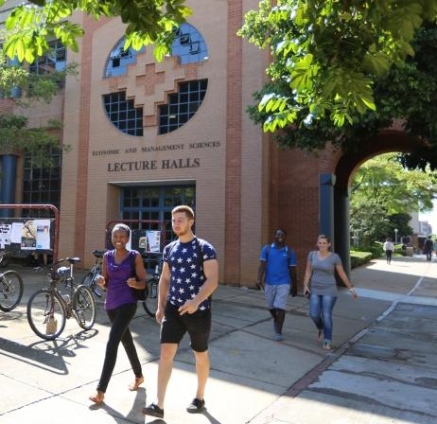
Emerging Researcher & Postgraduate Workshop
Finding appropriate literature
Presented by Marriette Mapheto
04 September 2024
Marriette.mapheto@up.ac.za

Slide 2
Outline
Topic Analysis
Finding literature
Library website overview
WorldCat library discovery tool
Google Scholar
Literature Review
Emerging Researcher & Postgraduate Workshop 4 September 2024

Slide 3
Analise your topic
My topic is - What is the Impact of COVID on student wellbeing
Keywords:
Impact AND (Covid or COVID 19 or Coronavirus) AND (student or “University student” or college student or postgraduate or undergraduate) AND (wellbeing or well-being)
Emerging Researcher & Postgraduate Workshop 4 September 2024

Slide 4
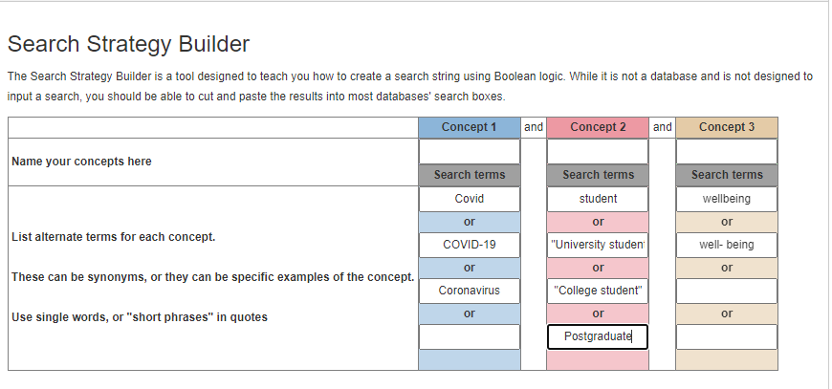
Search strategy builder
Emerging Researcher & Postgraduate Workshop 4 September 2024

Slide 5
Finding literature
Different types of materials available
Books
Articles
Theses
Official websites e.g. The South African Government, United Nations, Professional bodies website
Grey literature : organizational reports
What you will need depend on your topic and field of study
Emerging Researcher & Postgraduate Workshop 4 September 2024

Slide 6
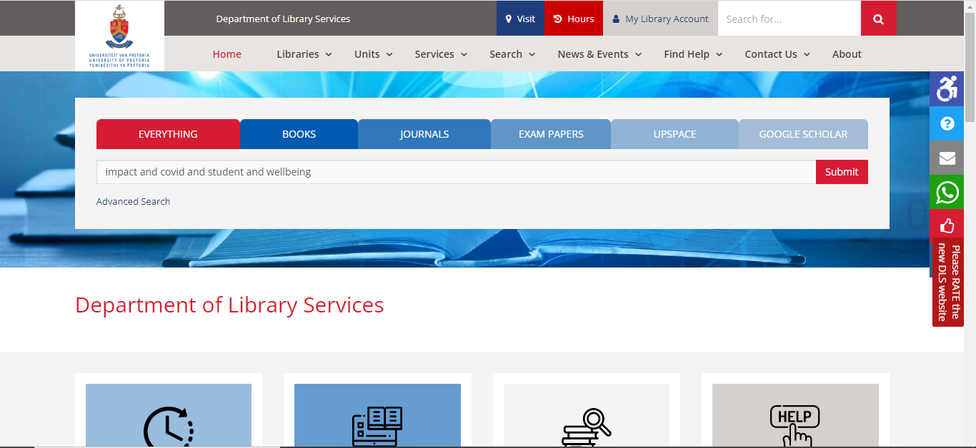
Library webpage www.library.up.ac.za
Emerging Researcher & Postgraduate Workshop 4 September 2024

Slide 7
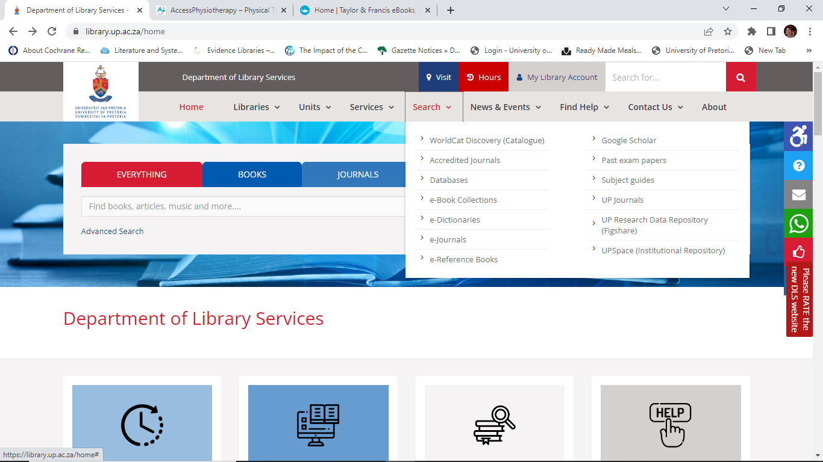
Emerging Researcher & Postgraduate Workshop 4 September 2024

Slide 8
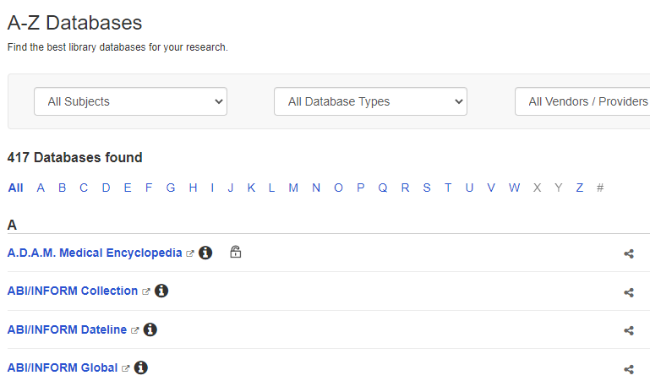
Emerging Researcher & Postgraduate Workshop 4 September 2024

Slide 9
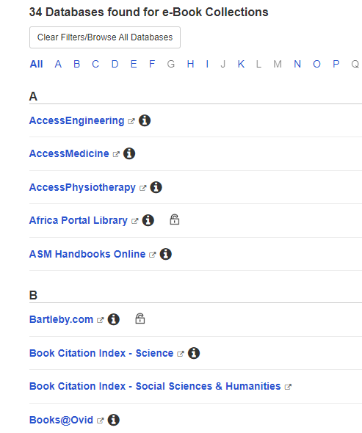
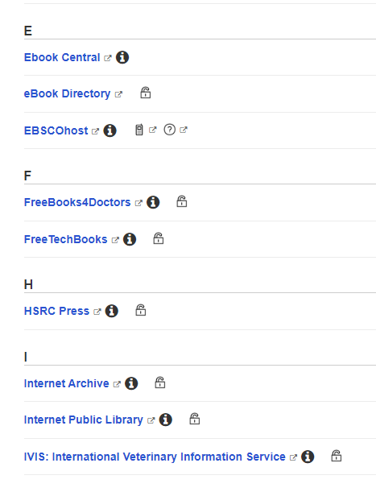
Emerging Researcher & Postgraduate Workshop 4 September 2024

Slide 10
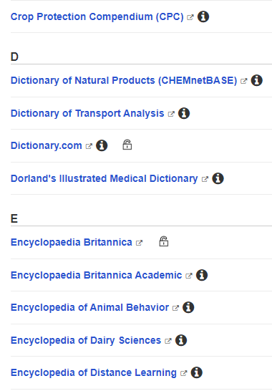
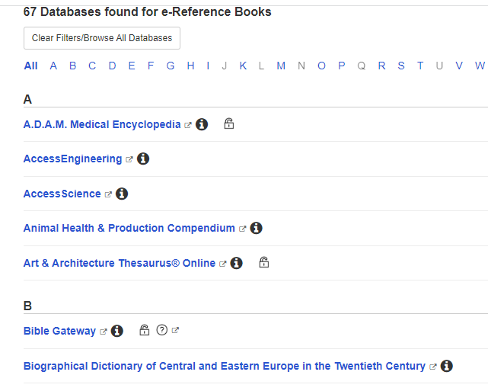
Emerging Researcher & Postgraduate Workshop 4 September 2024

Slide 11
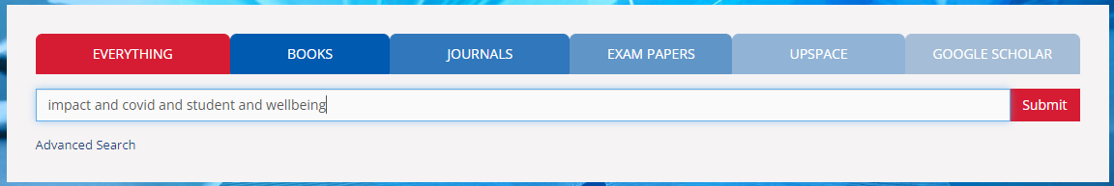
WorldCat discovery : Everything
Emerging Researcher & Postgraduate Workshop 4 September 2024

Slide 12
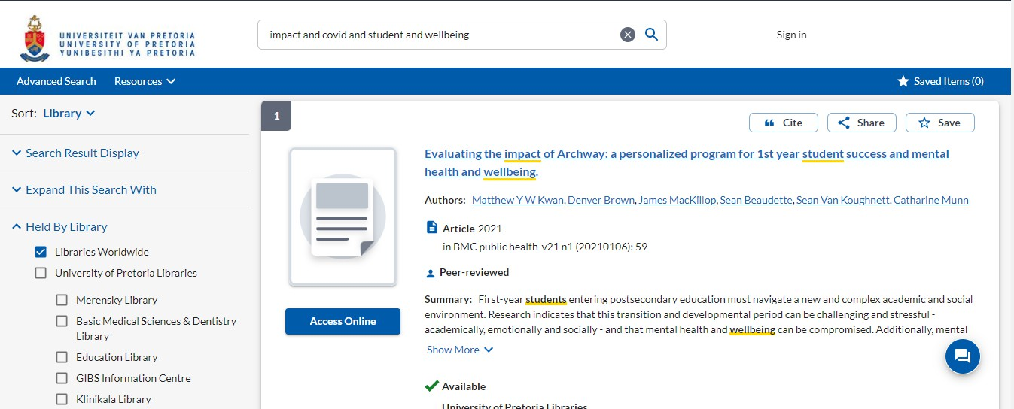
WorldCat single search
Emerging Researcher & Postgraduate Workshop 4 September 2024

Slide 13
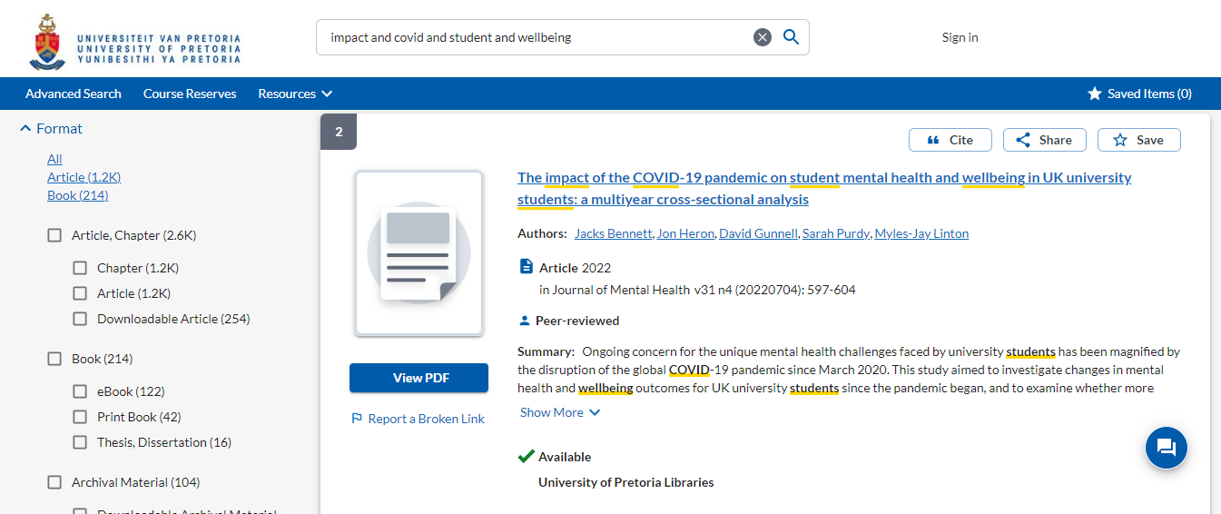
WorldCat single search
Emerging Researcher & Postgraduate Workshop 4 September 2024

Slide 14
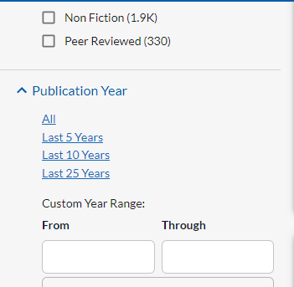
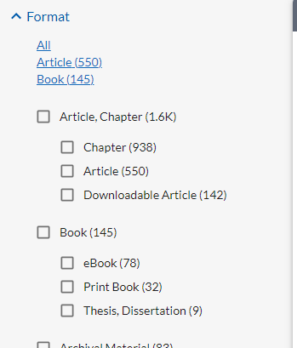
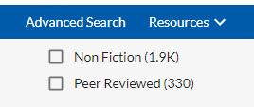
Limit your search
Emerging Researcher & Postgraduate Workshop 4 September 2024

Slide 15
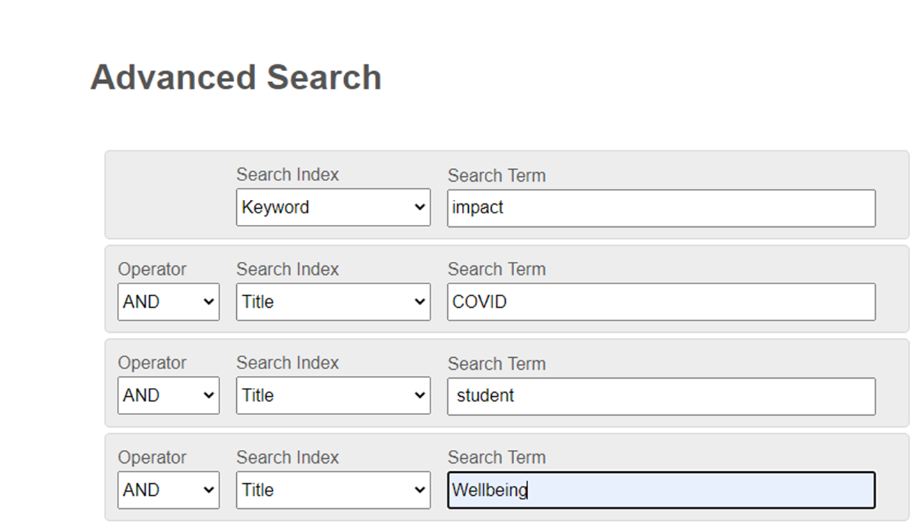
Search index e.g. keyword title or subject
Emerging Researcher & Postgraduate Workshop 4 September 2024

Slide 16
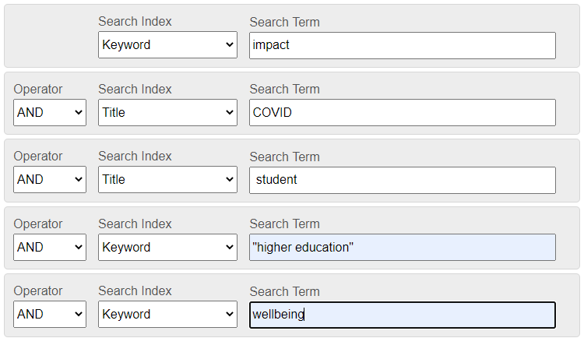
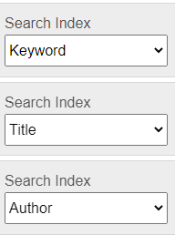
Add additional search terms by adding a row or change search index
Emerging Researcher & Postgraduate Workshop 4 September 2024

Slide 17
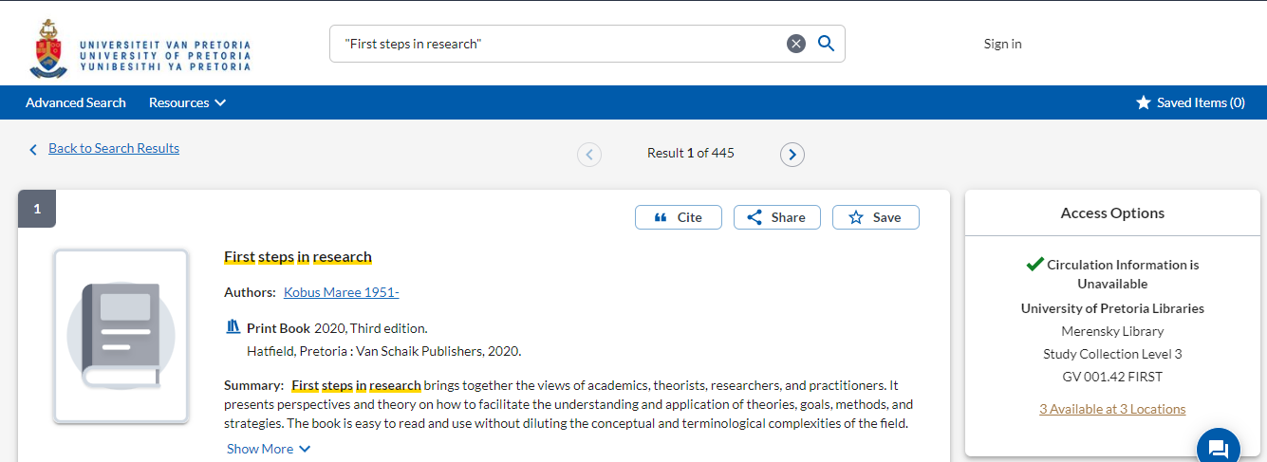
Searching for books
Emerging Researcher & Postgraduate Workshop 4 September 2024

Slide 18
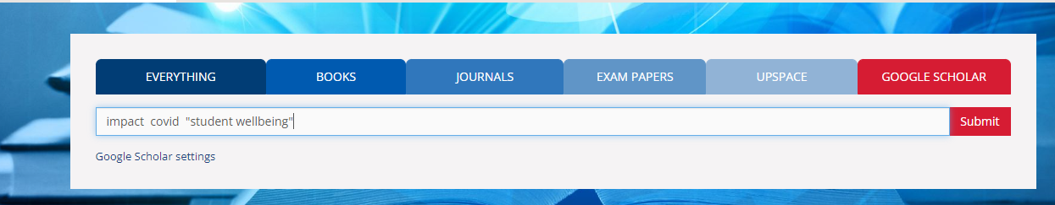
Google Scholar
Searching with “” for “phrase searching”
Emerging Researcher & Postgraduate Workshop 4 September 2024

Slide 19
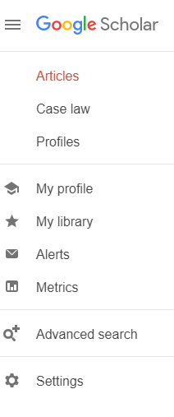
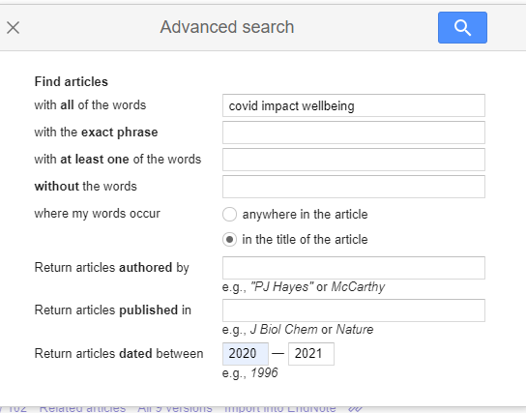
Google Scholar
Settings
Emerging Researcher & Postgraduate Workshop 4 September 2024

Slide 20
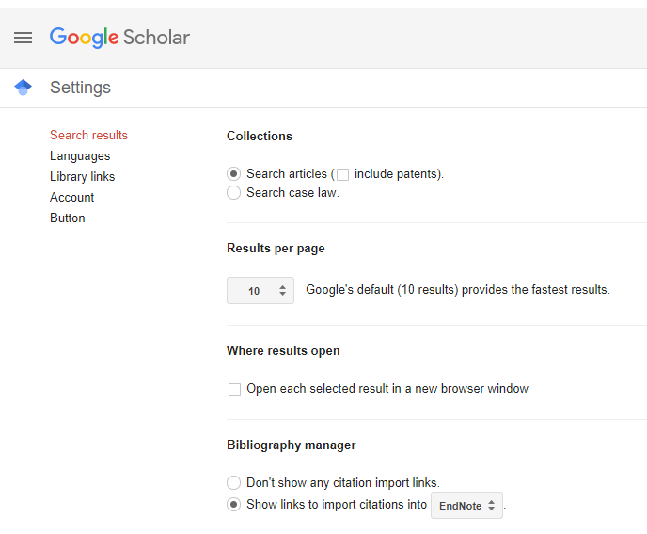
Settings: Library links & Endnote
Emerging Researcher & Postgraduate Workshop 4 September 2024

Slide 21
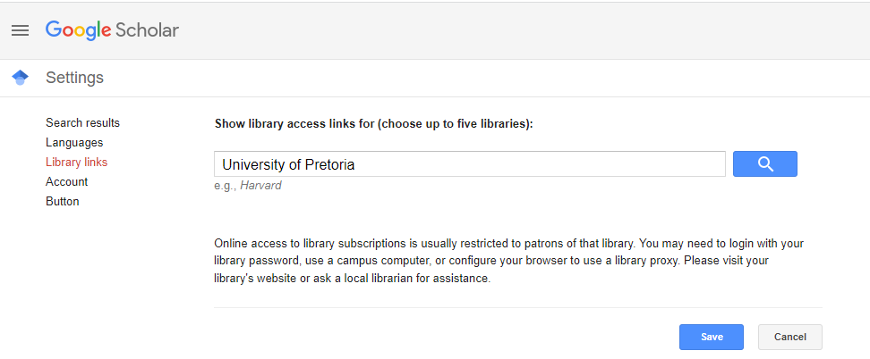
Library links
Type University of Pretoria and click on search
Emerging Researcher & Postgraduate Workshop 4 September 2024

Slide 22
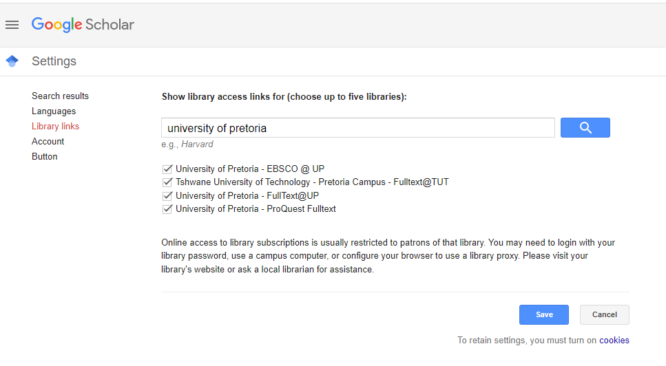
Tick all the boxes and click on save
Emerging Researcher & Postgraduate Workshop 4 September 2024

Slide 23
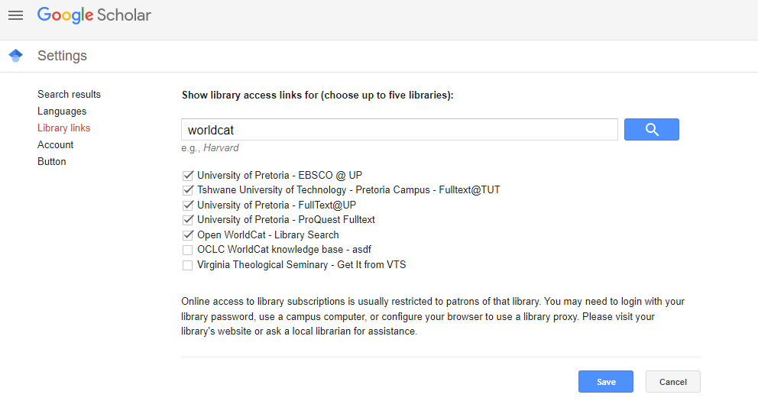
Type WorldCat, tick the Open WorldCat box indicated and click on save
Emerging Researcher & Postgraduate Workshop 4 September 2024

Slide 24
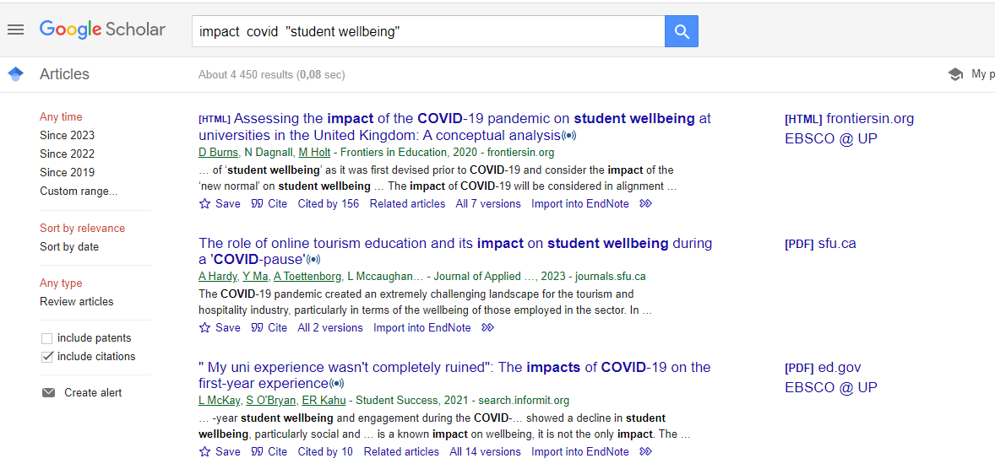
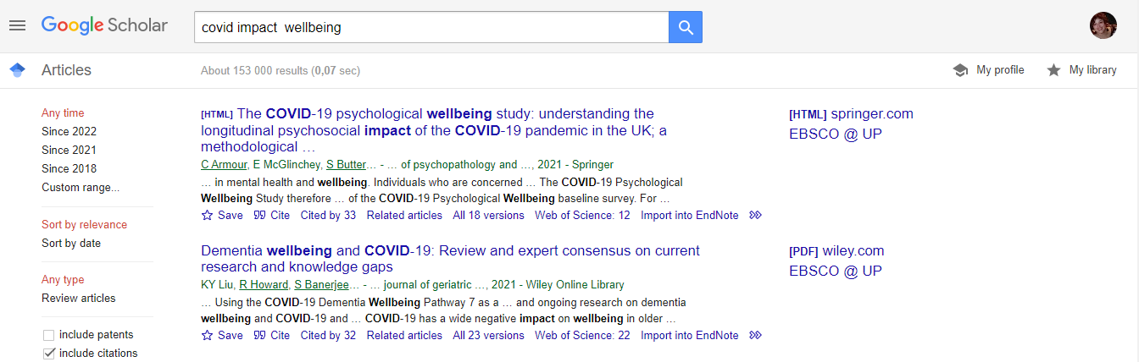
Google Scholar
Results
Emerging Researcher & Postgraduate Workshop 4 September 2024

Slide 25
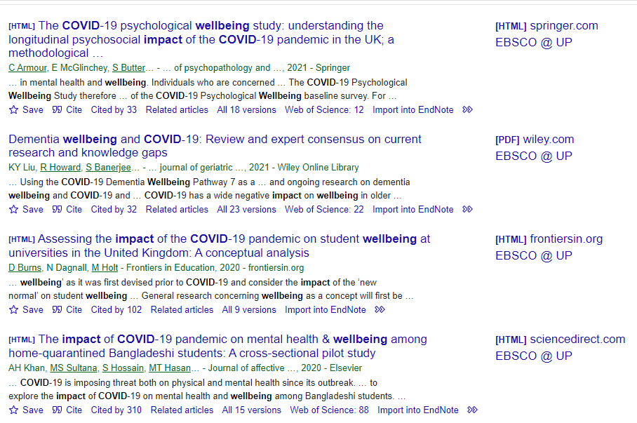
Google Scholar
Emerging Researcher & Postgraduate Workshop 4 September 2024

Slide 26
Literature review
"a piece of academic writing demonstrating knowledge and understanding of the academic literature on a specific topic placed in context. A literature review also includes a critical evaluation of the material” (University of Edinburgh, 2023)
Reading combined with critical analysis can help to refine a topic and frame research questions
Establishes your familiarity with and understanding of current research
When doing and writing a literature review, it is good practice to:
summarise and analyse previous research and theories;
identify areas of controversy and contested claims;
highlight any gaps that may exist in research to date.
Emerging Researcher & Postgraduate Workshop 4 September 2024

Slide 27

THANK YOU!
Emerging Researcher & Postgraduate Workshop 4 September 2024

