Slide 1
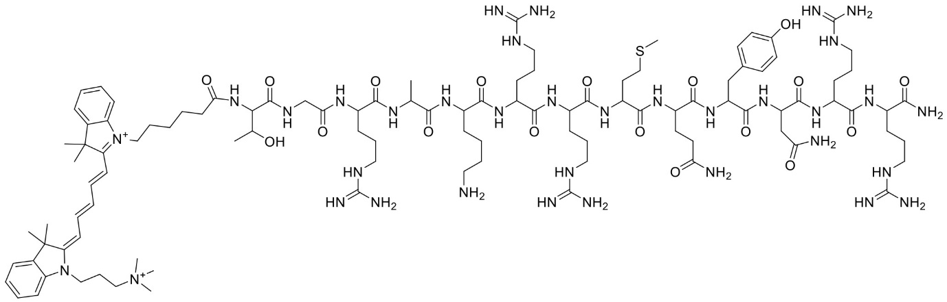
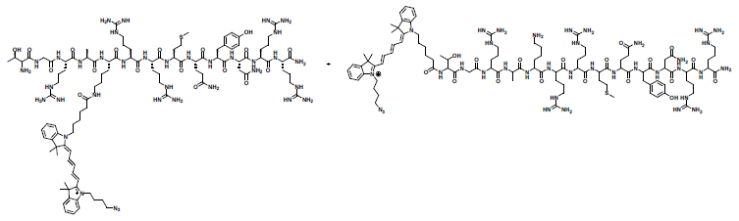
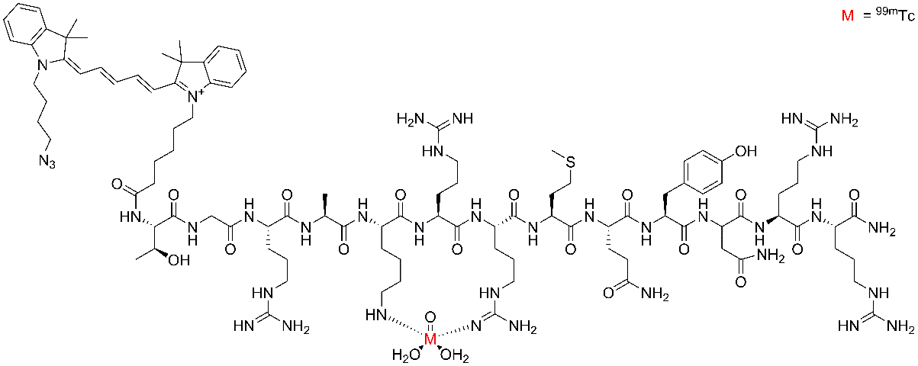
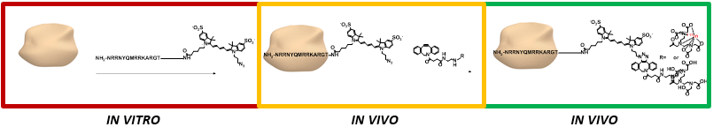
Fig. SI1 Chemical structures of UBI₂₉₋₄₁-Cy5 variants. (A) UBI₂₉₋₄₁-Cy5-Qamine, (B) Variants of UBI₂₉₋₄₁-Cy5-N₃ and schematic depiction of ^{99m}Tc labeled UBI₂₉₋₄₁-Cy5-N₃ according to Meléndez-Alafort et al. Nucl Med Biol. 2003;30(6):605, (C) Chemical structure of [¹¹¹ln]-DTPA-UBI. _{29–41}-Cy5, (D) Schematic presentation of the click reaction between S. aureus-[^{99m}Tc]-UBI_{29–41}-Cy5-N₃ and [¹¹¹In]-DTPA-DBCO
(A)
(B)
(C)
(D)

